Slide 1
Restarting Cataract Services
19 May 2020 12.30-2pm
Introduction to the principles | Michael Burdon
COVID-19 discussion and consent for patients considering cataract surgery | Philip Bloom
Risk and prioritisation tools | Melanie Hingorani
Safe efficient pathways | Jonathan Bhargava
The Sunderland experience | Lawrence Gnanaraj
Questions and discussion | Declan Flanagan

Slide 2
Restarting Cataract Services: Principles
Michael Burdon
President, The Royal College of Ophthalmologists

Slide 3
Principles
The criteria for cataract surgery are unchanged
When patients are aware that their quality of life is being limited by their vision
When the surgeon believes that cataract surgery will improve their eyesight
The consenting process must include a discussion of:
The risk of COVID infection to patients and their families
Measure put in place to minimise this risk

Slide 4
Principles
Use prioritising criteria to direct care to those most at need
Consider minimising waiting lists by offering surgery to those who have already had their pre-operative assessment before starting to see new referrals

Slide 5
Principles
Limit the number of patients per list until measures put in place to minimise patient-to-patient and staff-patient contact have been demonstrated to work
staggered arrival times
? pre-dilated
? less than 90 minutes in hospital
? bilateral simultaneous surgery

Slide 6
Principles
Link pre-operative appointments to dates for surgery and post-operative review
Initial telephone/video consultation
(One week later): biometry, eye examination, consent
One week later: surgery

Slide 7
Principles
Consider systematic swabbing of patients (and staff)
Pre-op clinic, followed by self-isolation
Day of surgery

Slide 8
Principles
Begin surgical training within a few weeks of restarting services
Surgical simulation
Senior trainees

Slide 9
RCOphth Webinar : Restarting Cataract Services COVID-19 discussion and consent for patients considering cataract surgery
Philip Bloom
Consultant Ophthalmic Surgeon
The Western Eye Hospital, London
The Hillingdon Hospital, London
President, United Kingdom & Ireland Society of Cataract & Refractive Surgeons (UKISCRS)
Chairman, International Glaucoma Association (IGA)
Charity Registered: in England & Wales No 274681; in Scotland No SC041550
Associate Professor, Plymouth University School of Medicine & Dentistry
Trustee & Council Member, Royal Society of Medicine (RSM)
Charity Registered in England & Wales No 206219
Honorary Senior Lecturer
Imperial College School of Medicine, London
Honorary Clinical Senior Lecturer
University College, London

Slide 10
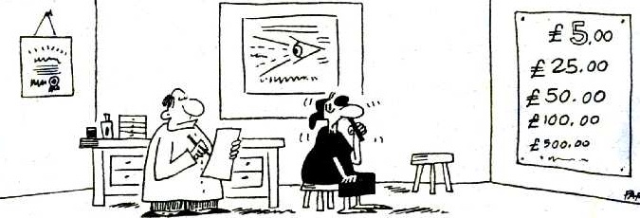
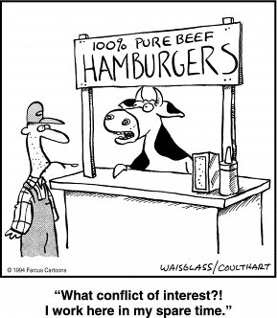
Financial Declaration or
Potential Conflicts of Interest
NHS consultant ophthalmologist with a private practice
No financial interest in products/companies mentioned
Not a paid consultant for any company
Have received research funding and/or one-off payments for advisory boards and/or speaker honoraria from:
Iridex, Glaukos, EndoOptiks, Allergan, Alcon, Ciba

Slide 11
Program summary
Minutes | Topic | Speaker | Title
10 | Introduction to the principles | Mike Burdon | RCOphth President
10 | COVID-19 discussion and consent for patients considering cataract surgery | Philip Bloom | UKISCRS President
10 | Risk and prioritisation grading tools | Melanie Hingorani | RCOphth Chair Professional Standards
10 | Safe efficient Pathways | Jonathan Bhargava | Consultant Ophthalmologist, Countess of Chester Hospital
10 | The Sunderland experience | Lawrence Gnanaraj | Consultant Ophthalmologist, Sunderland Eye Infirmary
30 | Questions and discussion | Declan Flanagan & Panel | RCOphth Vice President
PB: COVID-19 & Cataract
(Eye) timeline
UK health policy
Ophthalmology policies
Elective ‘reboot’ and issues
PPE; Phaco as an AGP
Who should be listed
Benefit & risk
Priority vs rationing

Slide 12
UKISCRS & RCOphth
Both historic national organisations
OSUK 1880, FacOphth 1946, COphth 1988, RCOphth 1993 (MB – pres. #12)
UKIOIS 1976, UKIIS 1977 (Neil Dallas) , UKISCRS 1995 (PB – pres. #22)
UKISCRS ‘youth’ reflects advent of sub-specialisation
Refractive surgery widely acknowledged to be a sub-specialty
Increasingly, cataract surgery regarded as a specialist area
Both represent ophthalmologists
Consultants & trainees
cf. IGA - represents patients
cf. RSM – represents medical professional education in general
Common aim – best patient care
Both depend on vital Council members
Recent collaborations between RCOphth & specialist societies
Produces clear national guidance with input from sub-specialists
Good for patients and all healthcare staff, including doctors

Slide 13
Eye-line of a Pandemic
Nov 2019 ---
Dec 2019 ---
Jan 2020 ---
Feb 2020 ---
Mar 2020 ---
April 2020 ---
May 2020 ---
June 2020 ---
July 2020 ---
17/11/19 first case detected (identified later, debated)
11/01/20 first death (China)
20/01/20 first death outside China
22/01/20 Public Health England moves risk to UK population from ‘very low’ to ‘low’
29/01/20 first UK death
11/02/20 risk to UK population moves from ‘low’ to ‘moderate’
13/02/20 first specific UK PPE advice
07/02/20 ophthalmologist Dr. Li Wenliang (‘whistleblower’) dies
26/02/20 I cancel my ski trip to Italy
28/02/20 first UK national dies (Diamond Princess)
02/03/20 first UK death (care home)
12/03/20 risk to UK population moves from ‘moderate’ to ‘high’
17/03/20 non-urgent UK elective healthcare activity suspended ‘within 30 days’
15/04/20 all elective activity halts,’ for at least 3 months’ - to 17/06 or 15/07
18/03/20 UK Schools close
19/03/20 first day with no new reported infections in China
20/03/20 UK pubs & restaurants ordered to close
22/03/30 1.5m at highest risk advised to shield at home
23/03/20 UK lockdown
02/04/20 PHE PPE advice updated
09/04/20 RCOphth updated advice for PPE & staff protection in ophthalmology
17/04/20 UKISCRS/RCOphth joint COVID-19 cataract surgery guidance
29/04/20 RCOphth guidance: ‘Reopening & redeveloping services during COVID-19’
06/05/20 RCOphth tool: ‘Prioritisation of ophthalmic procedures in COVID-19’
07/05/20 UKISCRS/RCOphth joint document assisting restoration of cataract surgery services
19/05/20 RCOphth Webinar: Restarting Cataract Services
01/07/20 elective activity resumes (?)

Slide 14
https://www.health.org.uk/news-and-comment/charts-and-infographics/covid-19-policy-tracker

Slide 15
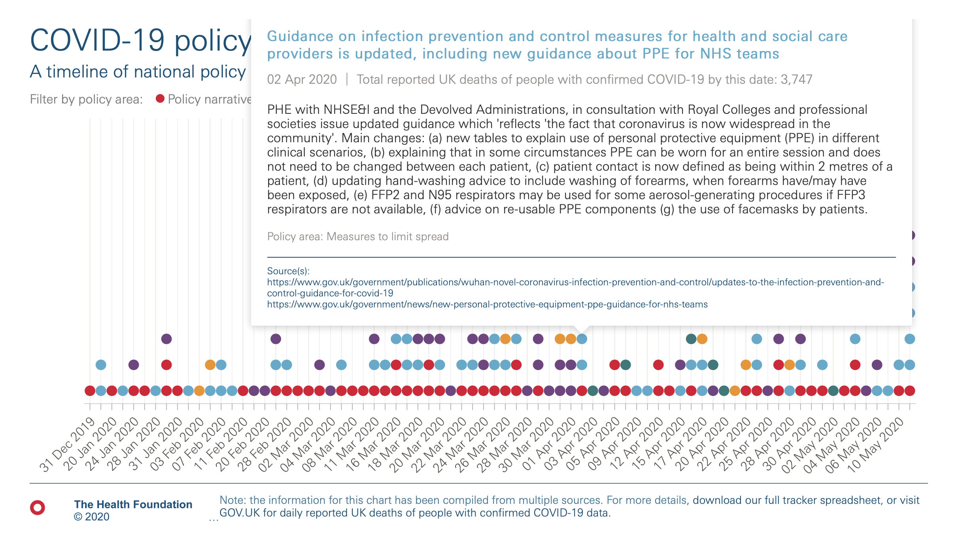
https://www.health.org.uk/news-and-comment/charts-and-infographics/covid-19-policy-tracker

Slide 16
https://www.health.org.uk/news-and-comment/charts-and-infographics/covid-19-policy-tracker

Slide 17
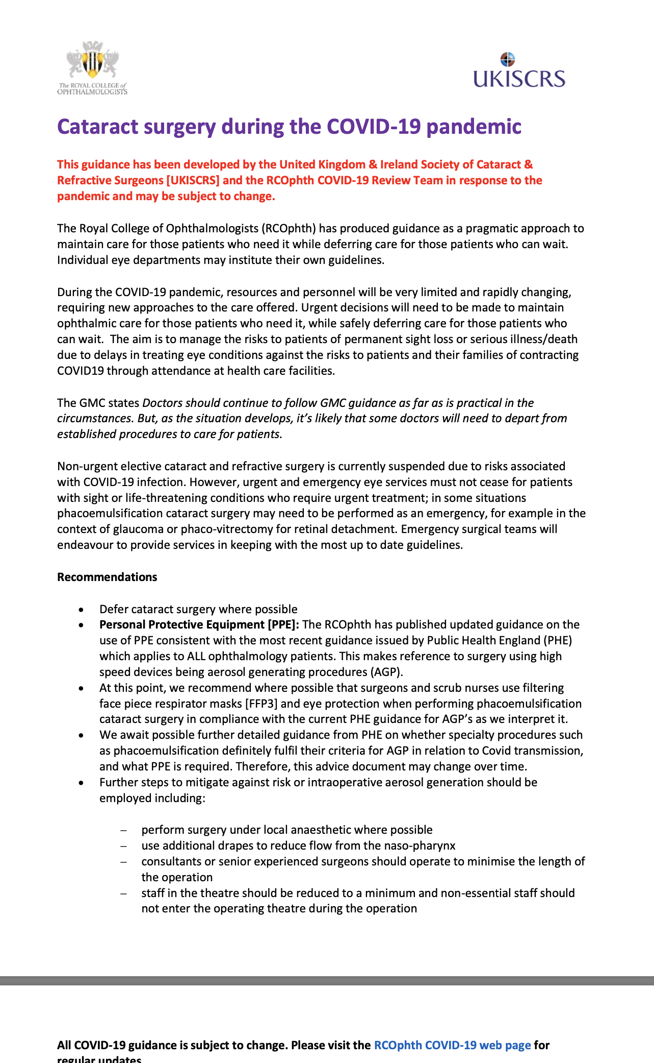
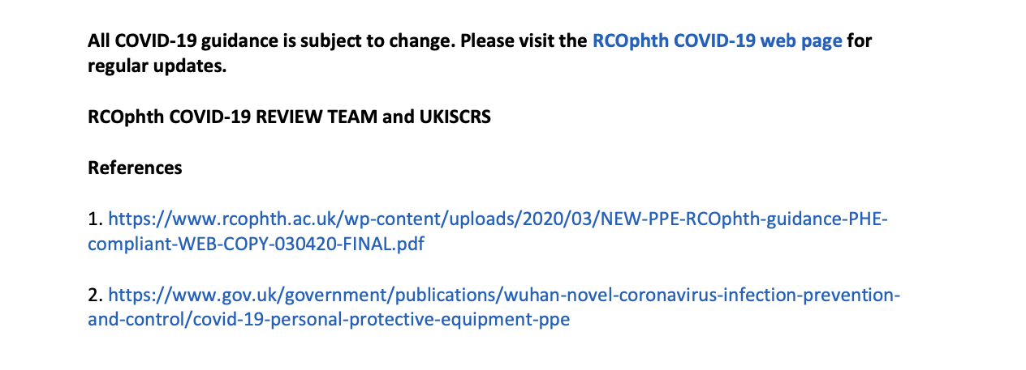
https://www.rcophth.ac.uk/about/rcophth-covid-19-response/

Slide 18
Let’s run the roadmap up the flagpole and make it a framework

Slide 19
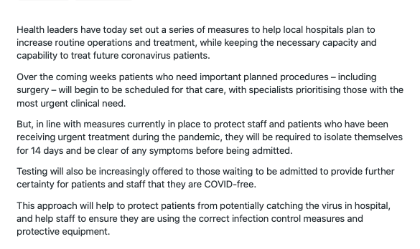

Slide 21
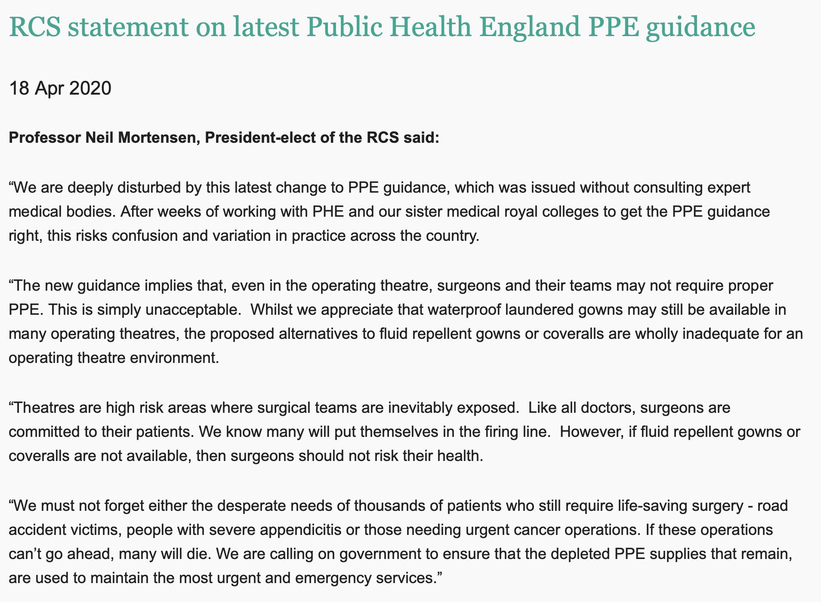
Protection is an emotive issue
Highly personal issue
The key was in the name PPE …
Uncertainty is uncomfortable
Public debate
Professional debate
Seeing eye-to-eye with PHE?
Appropriate to wait for evidence of harm?
Cost (FFP3 @ ~ £1-2 in NHS) vs availability
Risk factors
BAME
Age, gender, co-morbidity
Type of work; ICU, A&E, eyes …
AGP
Intubation / extubation
High speed devices
Drills - DCR
Vitrectomy
Phaco?
Diathermy?
Irrigation?

Slide 22
UK PPE

Slide 23
PPE in ophthalmology

Slide 24
To AGP or not to AGP

Slide 25
Phaco ‘spray’ (Richard Haynes)

Slide 26
Phaco as an AGP
Aerosol: liquid/solid particle suspended in air
Usually invisible like pollen. can be visible like fog
Droplets sink onto surfaces, aerosols stay suspended
Phacoemulsification - demonstrable spray (mist)
Probably from vibration of fluid in contact with the extraocular part of the phaco sleeve
Spray probably results in both droplets and aerosol
Red herring?
What is being ‘aerosolised’ likely to have a minimal, if any, viral load
Povidone iodine is a highly effective anti-viral; tear film sterilised by pre-operative prep
Aqueous is fully replaced by the pre-phaco step of viscoelastic exchange
Despite irrigation, some aqueous may remain outside the eye at start of emulsification
This may be irrelevant as no current evidence of replicating virus in intraocular fluid
Absence of evidence is not evidence of absence
The spray effect can be reduced
Repeated (1/minute) application of HPMC (Kieren Darcy, personal communication)
Confined - containment system e.g. ‘the microscope drape’ (Louisa Wickham, personal communication)

Slide 27
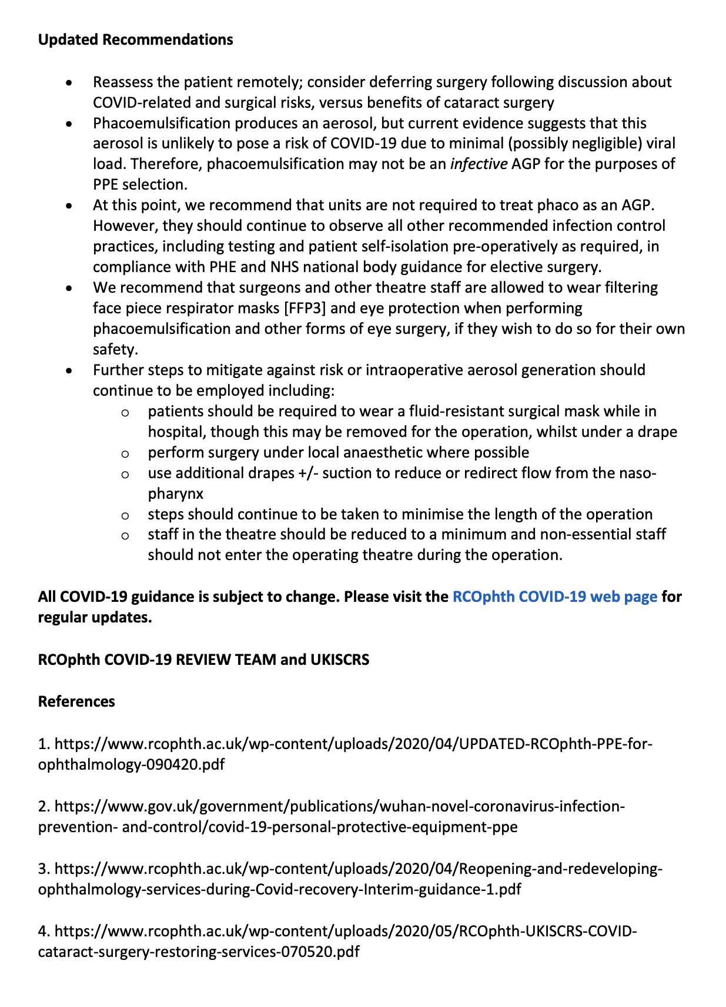

Slide 28
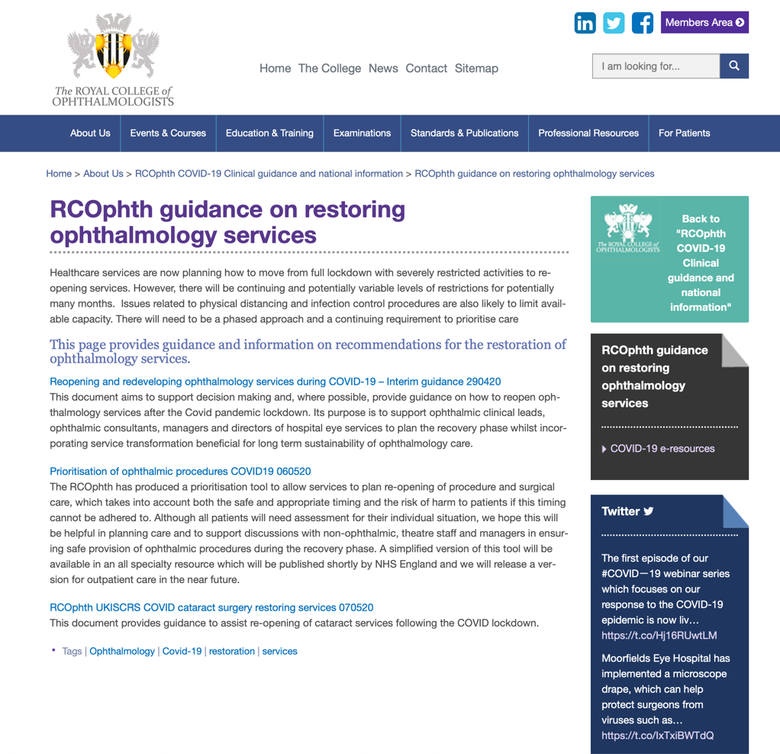
COVID-19 discussion and consent
‘Begin with the end in mind’
Protecting patients
Protecting staff
Protecting the bottom line (?)
Rebooting elective activity in general
Roadmap (NHSE 14/05/20)
Framework
Restarting cataract surgery specifically
What we will do the same (NICE)
What we will do differently now (UKISCRS/RCOphth 07/05/20)
What we may do differently in the future (watch this space)
Things may (will) never be quite the same again
The new normal …
https://www.rcophth.ac.uk/about/rcophth-covid-19-response/rcophth-guidance-on-restoring-ophthalmology-services/

Slide 29
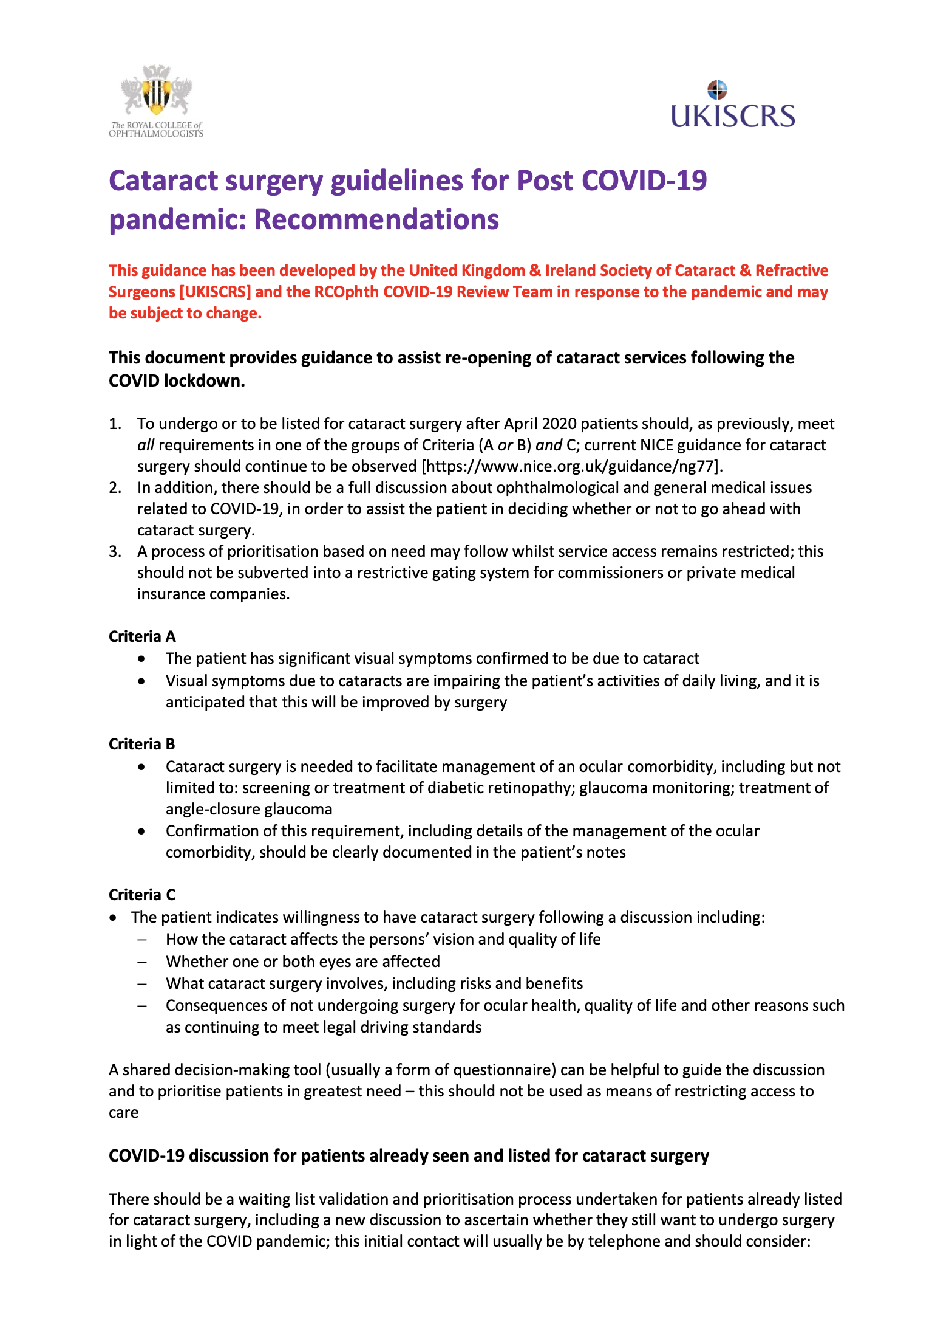
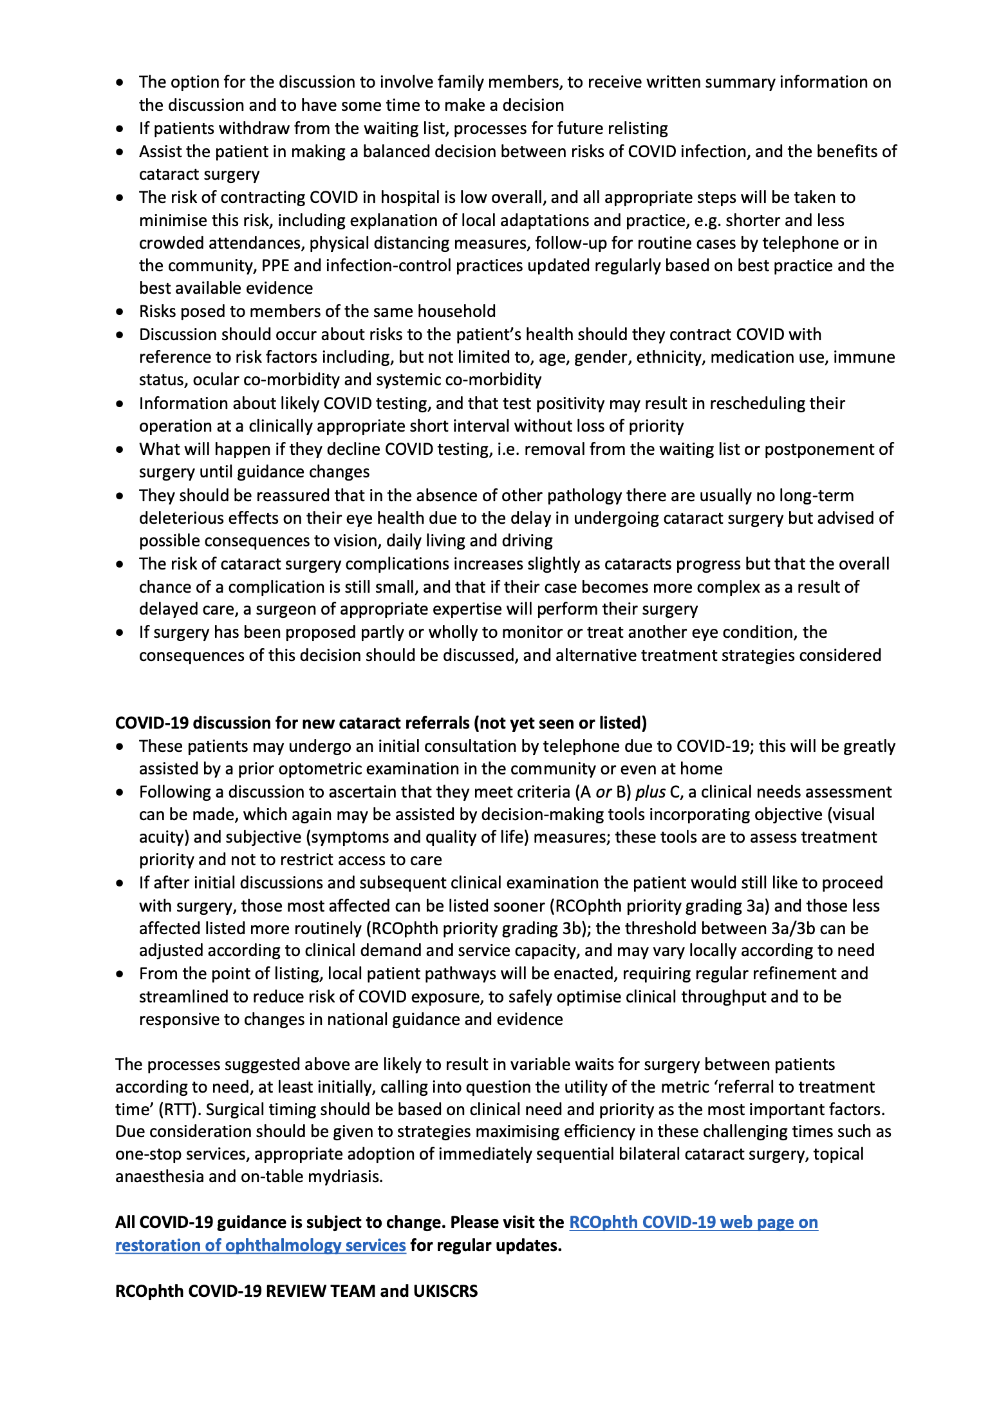

Slide 30
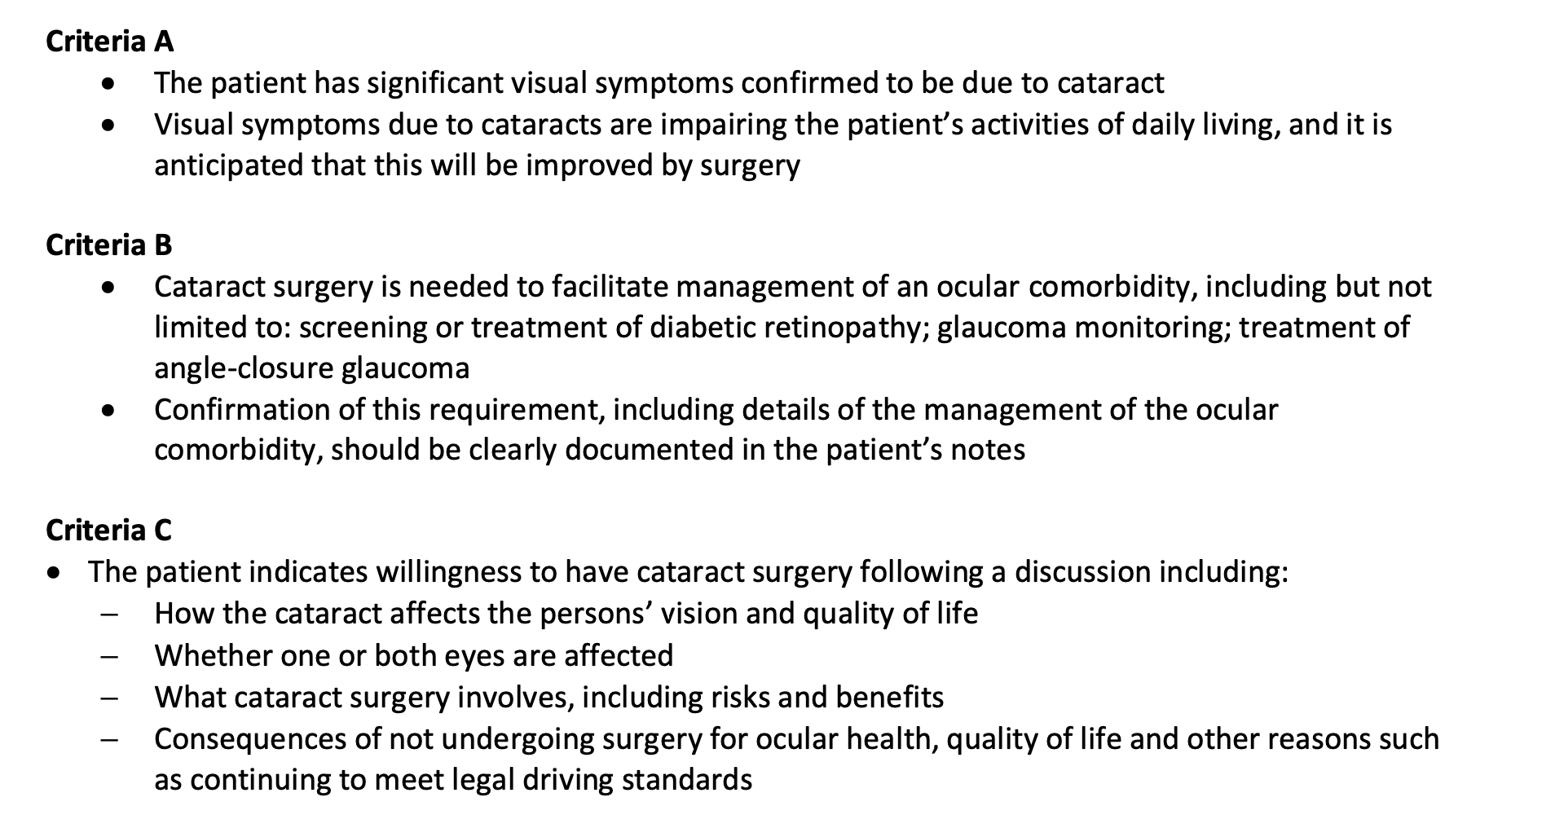
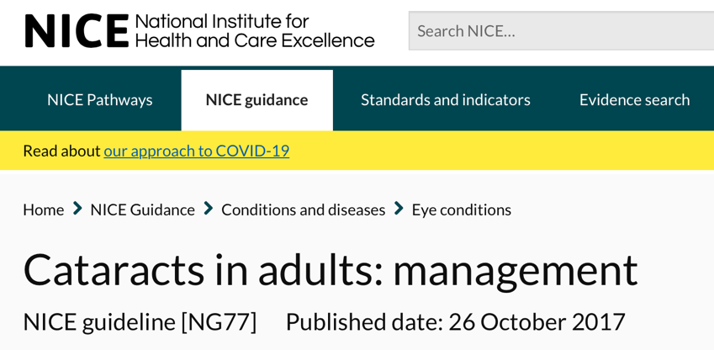
Listing for cataract surgery
Cataract BODMAS
(A/B)+C
Visually significant OR
Therapeutic PLUS
Consents to surgery
NICE guidance
New (old) ways of working
Remote consultations
Redesigned pathways
One-stop services
Bilateral cataract surgery
Rapid individual throughput (topical, on-table mydriasis etc.)
Reduced (community) follow-up

Slide 31
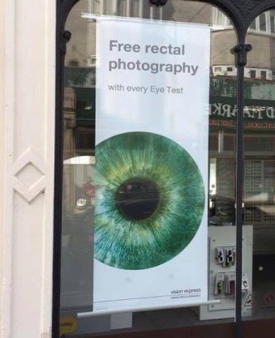
Benefit & risk
Risk & benefit (now)
Previously doctors have struggled to explain risk-benefit ratio
Now patients are explaining it to us …
Effect on service utilization (DNAs)
Risk & benefit (in the future)
Largely unknown variables
Testing
Contact tracing
Previous infection
Immunity
Vaccine
Medical treatments
Consent
Informed (is there any other kind?)
New discussions to be had

Slide 32
Priority vs rationing
Large numbers of patients on existing lists
Listed when the world was a different place (RTT was King)
Still appropriate to use our (precious) resources the same way?
Appropriate to consider effect on
Vision (objectively measured; VA and other measures of visual function)
Quality of Life (subjective, but attempt to make objective)
Greater priority for greater need?
Easy to confuse with rationing
Must not limit access to care
Should we be prioritise patients already under our care?
Variation in waiting times
Post-code lottery
Cherry-picking
Training vs service issues

Slide 33
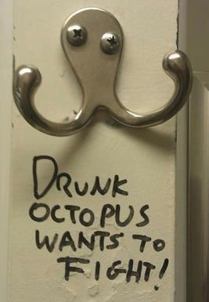
Final comments / summary
We have never faced such a challenge
Enormous (but quantifiable) financial cost
Incalculable human cost – life, limb, senses
Change has ensued
Unfeasibly swift
(Broadly) effective
Change may (ultimately) be for the better
Change can be embraced as an opportunity
Ultimately this may be good for patient care

Slide 34
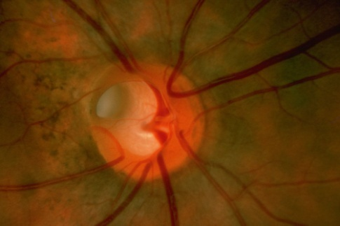
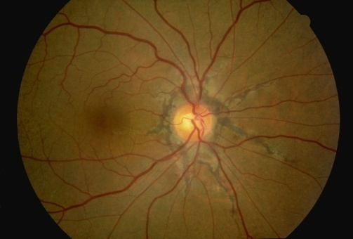
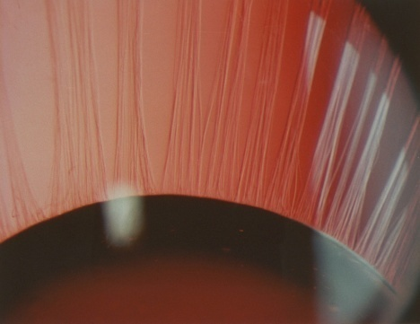
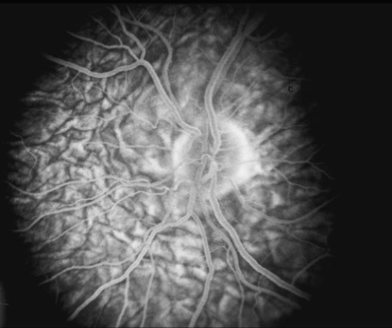
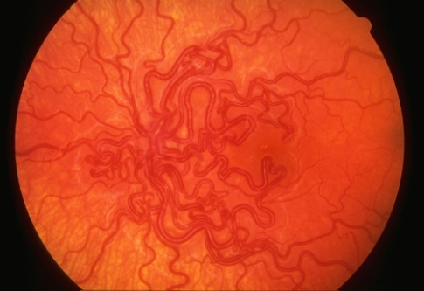
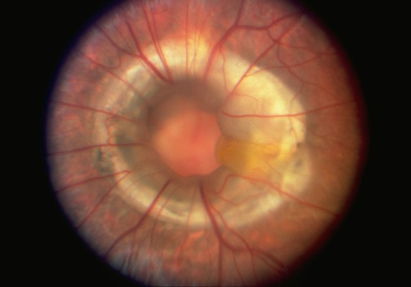
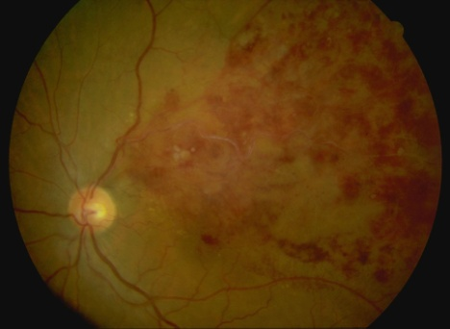
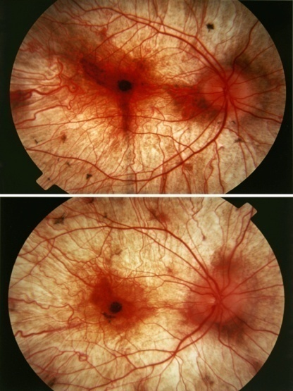
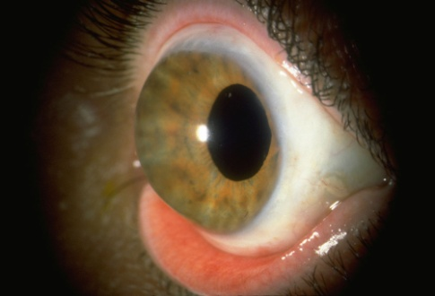
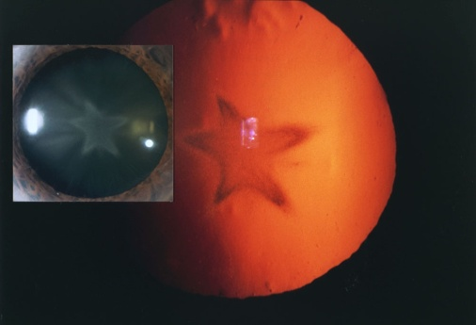
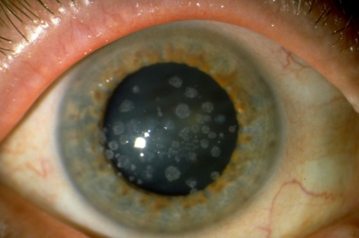
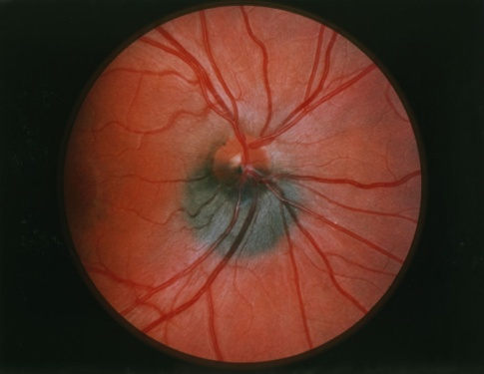
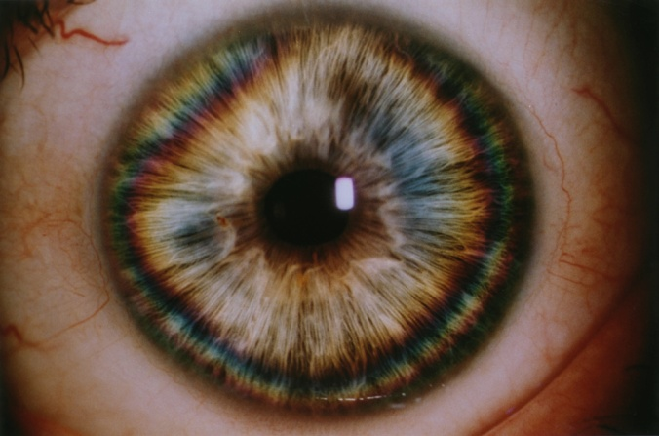
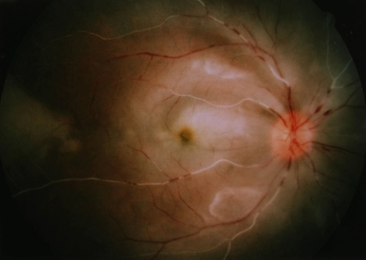
Thanks for watching …

Slide 35
Risk, Prioritisation and Grading
Melanie Hingorani RCOphth Chair Professional Standards

Slide 36
RCOphth advice on prioritisation of all care
Clinical ophthalmic
Likelihood of irreversible harm and rapidity of that harm from the eye condition - record risk on PAS as low/medium/high
Patients with greatest need of improvement: acuity, ability to work, independence, quality of life
Likelihood of significant benefit of care – if benefit marginal, less likely to prioritise
Number of patients who could benefit eg cataract surgery not high risk but restarting would bring rapid and significant benefit to many patients
Do surgical patients actually want to proceed in the current situation?
Risk of Covid spread
Risk to patients of Covid - minimise seeing patients more at risk of Covid and see less at-risk patients eg young, healthy
Risks to staff of Covid from activity

Slide 37
Service related
Care not a risk yet but unless catch up now, will generate an insurmountable capacity issue causing risk later
Considering first operating on all patients currently on the waiting list –balanced against the clinical priority of new patients
Prioritise surgery on clinical rather than waiting list/RTT criteria.

Slide 38
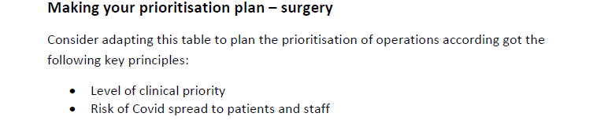
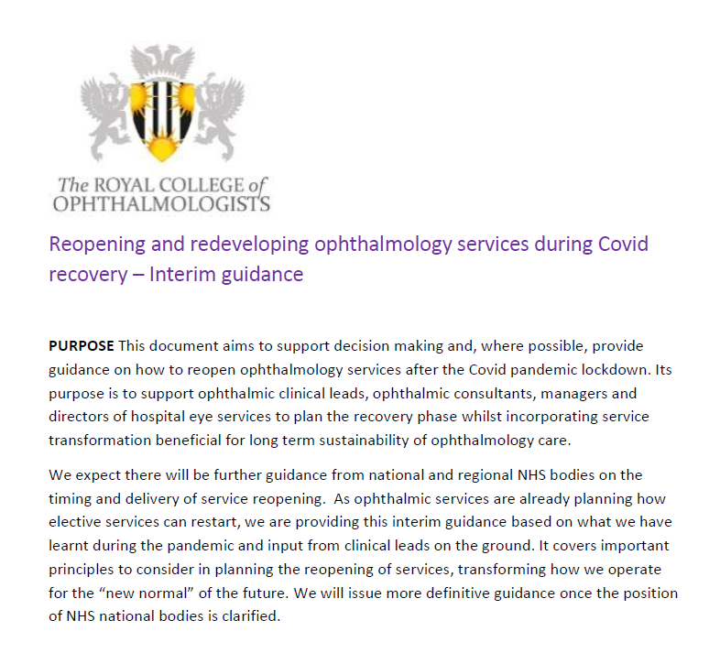
College guidance for prioritisation and risk stratification for recovery
Priority Grading |  | Definition | Possible Examples
1 | Sight threatening <3 months | Emergency work Urgent cases where irreversible loss of vision likely within 3 months Urgent oncology | Acute RRD Trauma Ocular oncology Retinoblastoma Glaucoma patients not tolerating diamox
2 | Sight threatening <6 months | Urgent cases where irreversible loss of vision likely within 6 months | Macular hole surgery Glaucoma surgery
3a | Sight restoring high priority | Restoring vision in only eye or allows patient to return to work | Cataract only eye Some squint
3b | Sight restoring / other | Improves VA, independence, QOL, other | Cataract Strabismus

Slide 39
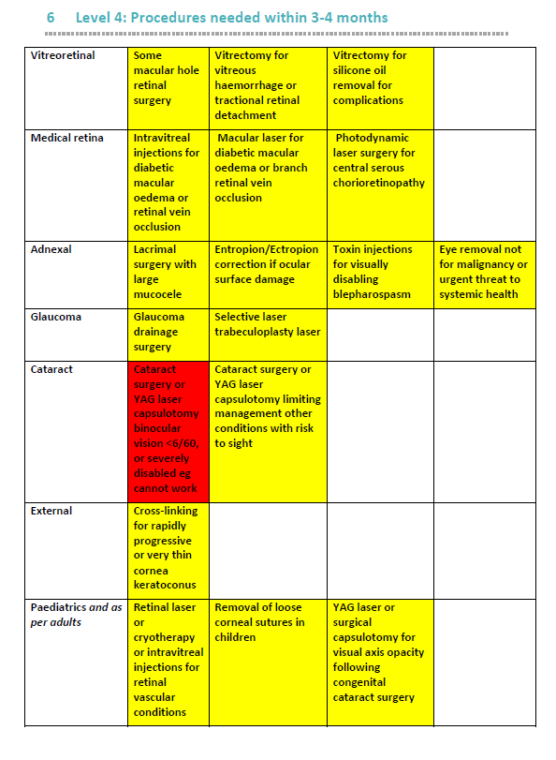
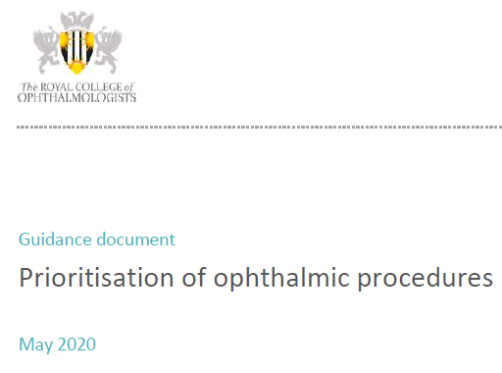

Slide 40
Prioritisation for those needing cataract surgery
Capacity significantly limited, have to prioritise
Prioritisation based on clinical and QoL criteria, surgical risks, patient Covid risk, not operational targets
+ve Criteria: surgery desirable soon eg severely limited binocular vision, inability to work or drive, high risk of falls, or surgery to manage other sight threatening disease e.g. DR
-ve Criteria: surgery undesirable soon eg old age, medical conditions, certain ethnicities or immunosuppression, high risk phaco complication
There’s a lot to take into account and a lot of patients to assess so tools would be helpful
There are published validated prioritisation or QoL tools for cataract, but:
may not combine subjective and objective findings
do not take into account factors relating to Covid risk
hospitals and groups are starting to make their own
they will require validation of the scoring over time

Slide 41
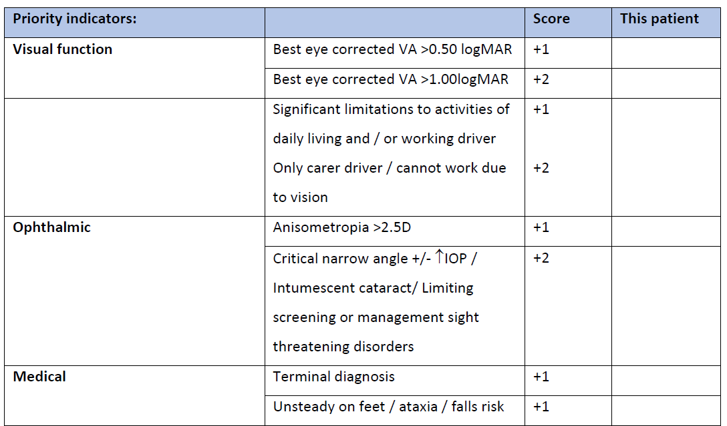
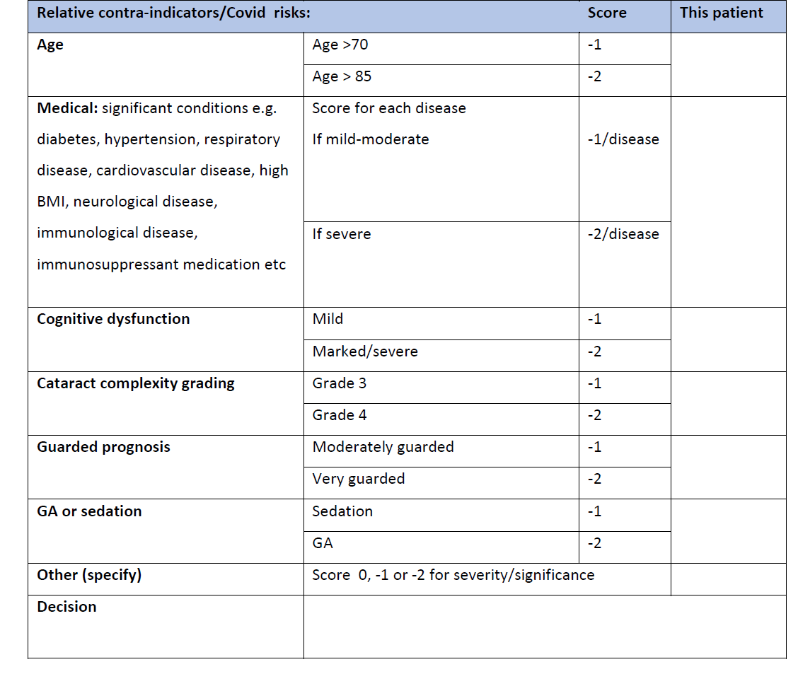

Slide 42
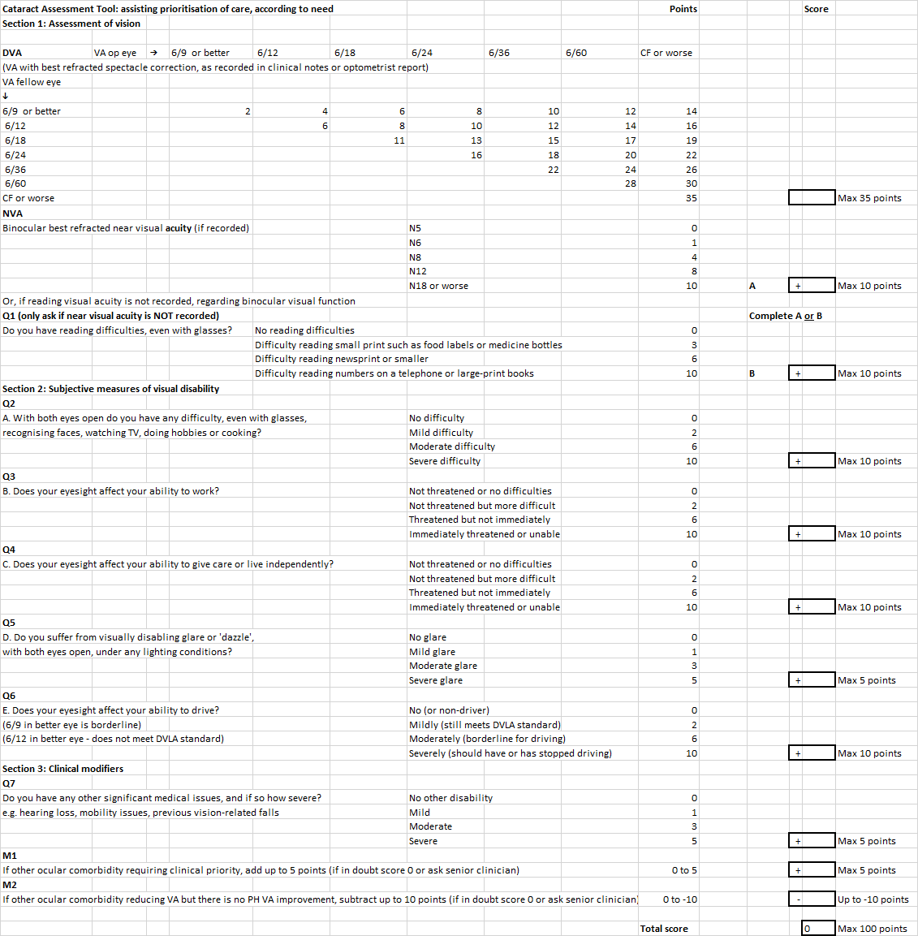

Slide 45
Grading systems- why do we need more?
PCR calculators exist
Visual outcome predictors exist
Wider/different factors influencing complexity, risk, extra needs which tell us surgeon/list/required theatre time for phaco surgery
Support units to record and/or score these factors for patients who are likely to require more theatre time and/or a more experienced surgeon to perform their cataract operation
Provision of a consistent simple overall grading score
This will support scheduling and planning efficient lists
Need to establish new benchmarks and compare between units

Slide 46
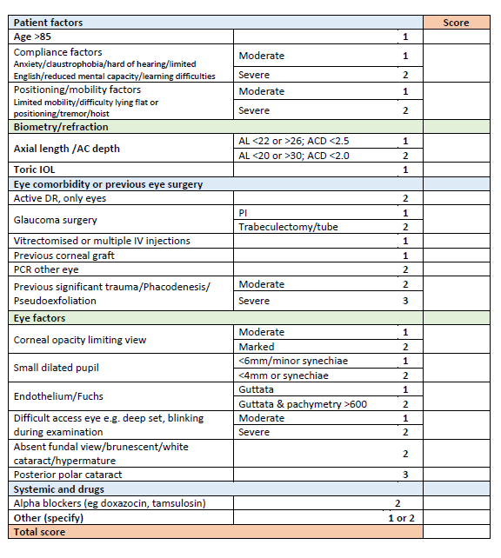
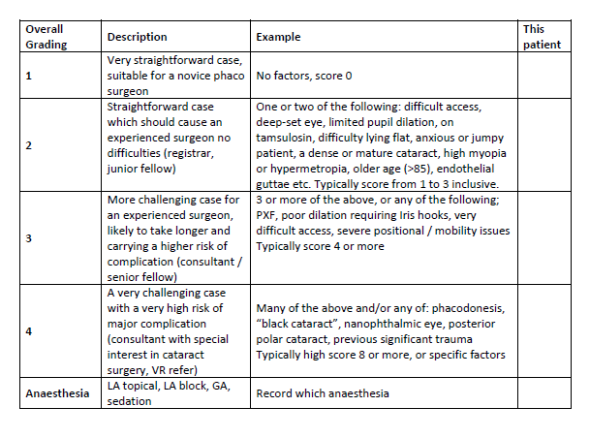

Slide 47
Coronavirus cataract recovery action plan
Jonathan Bhargava
Countess of chester nhs trust
Royal college of ophthalmologists covid webinar
18th May 2020

Slide 48
Principles of the plan
Telephone assessment
1-stop cataract assessment clinic
Consent issues
Day of surgery
Staffing requirements
Advantages
Disadvantages
Summary

Slide 49
principles
To minimise risk for patients and staff, and to optimise care accessibility for patients by:
Minimising unnecessary patient – staff interaction
Minimising amount of time the patient is present in the hospital environment
Provide practical methods to reduce risk of virus transmission during interactions
Promote shared decision making with patients through full awareness of risks and benefits of surgery and risks of and methods to minimise coronavirus transmission
To provide a safe, kind and effective cataract pathway for patients currently waiting for surgery and new cataract referrals
To improve upon current pathways
To provide help to NHS trusts to ‘hit the ground running’ when lockdown has ceased

Slide 50
Steps to mitigate coronavirus risk: Telephone Pre- assessment - by Nurse practitioner
PATIENTS QUESTIONED REGARDING:
Coronavirus symptoms and contact with infected people – to reduce likelihood of ‘positive’ patients attending
Patient advised to self-isolate 2 weeks prior to admission (recent NHS England guidance)
Appetite for cataract surgery - to ensure patients are symptomatic and wish to proceed with surgery with usual surgical risks
Appetite for cataract surgery in current coronavirus situation – ensuring patient is aware of risks but mitigating factors are able to be explained (shared decision-making tool)
Medical health – to ensure patients attending cataract clinic are medically fit for surgery
MRSA history
Suitability for a ‘low interaction’ appointment thus preventing unnecessary hospital visits
Patient booked for cataract clinic and sent cataract information leaflet and consent form to peruse prior to assessment
All key information recorded on a ‘ summary proforma’ that will be present throughout the patient episodes (clinic and theatre) thus reducing repetition

Slide 52
Steps to mitigate coronavirus risk: at Cataract clinic assessment
Primary nurse to perform vision, BP pulse, iCare, biometry, dilate & swab patient, limiting patient-staff interaction
Primary nurse will be able to use 1 ‘set’ of PPE per patient episode – reducing waste
Patients to wear appropriate PPE (surgical masks)
Patients swabbed for coronavirus at assessment – reduces risk of being ‘positive’ for theatre
Patient advised to self-isolate until surgery
Surgery organized soon after assessment (72hours)*
Patient assessed by surgeon
Patient counselled, listed for surgery and consented, IOL chosen and recorded
Patient given dilating drops with explicit instructions to administer them 1 hour prior to surgery in the eye to be operated upon.
This process should take 40 minute
*alternatively, swab taken later, 72 hours preop at hospital/GP/via post

Slide 53
Cataract clinic timeline
0830 | 0835 | 0840 | 0845 | 0900 | 0855 | 0900 | 0905 | 0910 | 0915 | 0920 | 0925 | 0930 | 0935 | 0940 | 0945 | 0950 | 0955 | 1000 | 1005 | 1010 | 1015 | 1020 | 1025 | 1030 | 1035 | 1040 | 1045 | 1050 | 1055 | 1100 | 1105 | 1110 | 1115 | 1120 | 1125 | 1130 | 1135 | 1140 | 1145 | 1150 | 1155 | 1200 | 1205 | 1210
 |  |  |  | Nurse Practitioner
 |  |  |  | Surgeon
Biometry, iCare, Corona swab, Dilate
Surgeon assess, counsel and consent
Patient goes home
Visual acuity,
BP & Pulse
5 | 5 | 5 | 5 | 5 | 5 | 5 | 5
Patient 1
Patient 2
5 | 5 | 5 | 5 | 5 | 5 | 5 | 5
Patient 3
Patient 4
Patient 5
Patient 6
Patient 7
Patient 8
Patient 9

Slide 54
Consent issues
Patient has had surgical and coronavirus risks explained (shared decision-making tool) at pre-assessment telephone call 2 weeks prior
Patient has been made aware of extra coronavirus precautions
Patient aware of risk of COVID-19 (RCOphth cataract COVID consent form)
Patient should have read cataract information leaflet and consent form prior to cataract clinic
Therefore consent at cataract clinic with surgery within 72 hours is not impinging on a safe, informed consent process
Patient is able to change their mind prior to surgery

Slide 55
Scheduling and number of patients on a theatre list
Treat the cataract clinic as the pre-operative ward wound
Stratify surgical risk and timing factors (eg cannot lie flat) at cataract clinic clearly and consistently on the summary proforma to allow the surgeon and booking clerks to organize lists appropriately
More ‘routine’ cases able to be performed per list
Stratifying will enable cases or lists to be provided for trainees
Complex cases will be able to be accounted for by separate lists or different planned appointment and planned longer theatre/surgical time

Slide 56
Steps to mitigate coronavirus risk: at surgery
Patient is coronavirus negative from swab at assessment
Staggered admissions to limit patient-patient exposure
Patient arrives pre-dilated reducing time in hospital environment (can use top up with dilating pellet by nurses or intracameral dilating agent by surgeon on the table if not successful)
Patient to wear surgical mask
Same Primary nurse to admit, accompany patient to and in theatre and discharge patient limiting patient-staff interaction – flexible nursing team between clinic and theatres
Primary nurse will be able to use 1 ‘set’ of PPE per patient episode – reducing waste
Extra surgical draping possible but ‘normal’ surgical masks and gowns used NOT FFP3 unless COVID-19 positive

Slide 57
On day of surgery
Patient attends hospital 15 minutes prior to surgery
Patient is already dilated
Patient admitted by Primary nurse, operation site confirmed with patient, operating list and consent form and eye marked by Primary nurse/ surgeon (10 minutes) – possible 2-step marking process
Patient taken to theatre by Primary nurse (5 minutes)
Primary nurse administers local anaesthetic drops and iodine eye drops +/- skin prep in anaesthetic room
IOL reconfirmed & second step of marking– by surgeon
Primary nurse takes patient through to theatre and positions them ready for surgery
Scrub /theatre team trained to prep (if not done), drape, insert speculum and position microscope
Patient has cataract surgery (20 minutes ) – ‘surgical time’ could be extended to take into account theatre air changes
Primary nurse completes draft operation note
Primary nurse takes patient back to the ward and discharges them with pre-prepared drop and advice pack (10 minutes)
Patient in hospital for 45 minutes
Community follow-up in 4 weeks / telephone follow up with patient return VA/refraction data

Slide 58
La cataract theatre timeline 20 minutes surgical time
0830 | 0835 | 0840 | 0845 | 0850 | 0855 | 0900 | 0905 | 0910 | 0915 | 0920 | 0925 | 0930 | 0935 | 0940 | 0945 | 0950 | 0955 | 1000 | 1005 | 1010 | 1015 | 1020 | 1025 | 1030 | 1035 | 1040 | 1045 | 1050 | 1055 | 1100 | 1105 | 1110 | 1115 | 1120 | 1125 | 1130 | 1135 | 1140 | 1145 | 1150 | 1155 | 1200 | 1205 | 1210
 |  |  |  | Primary Nurse
 |  |  |  | Surgeon
Admission, operation site confirmed & marked
Surgery
Transfer to ward
Discharge home
5 | 5 | 5 | 5 | 5 | 5 | 5 | 5 | 5
Patient 1 Nurse 1
Transfer to theatre, drops
Patient 2 Nurse 2
Patient 3 Nurse 3
Patient 4 Nurse 1
Patient 5 Nurse 2
Patient 6 Nurse 3
Patient 7 Nurse 1
Patient 8 Nurse 2
Patient 9 Nurse 3

Slide 59
La cataract theatre timeline 30 minutes surgical time
0830 | 0835 | 0840 | 0845 | 0850 | 0855 | 0900 | 0905 | 0910 | 0915 | 0920 | 0925 | 0930 | 0935 | 0940 | 0945 | 0950 | 0955 | 1000 | 1005 | 1010 | 1015 | 1020 | 1025 | 1030 | 1035 | 1040 | 1045 | 1050 | 1055 | 1100 | 1105 | 1110 | 1115 | 1120 | 1125 | 1130 | 1135 | 1140 | 1145 | 1150 | 1155 | 1200 | 1205 | 1210
 |  |  |  | Primary Nurse
 |  |  |  | Surgeon
Admission, operation site confirmed & marked
Surgery
Transfer to ward
Discharge home
5 | 5 | 5 | 5 | 5 | 5 | 5 | 5 | 5 | 5 | 5
Patient 1 Nurse 1
Transfer to theatre, drops
Patient 2 Nurse 2
Patient 3 Nurse 3
Patient 4 Nurse 1
Patient 5 Nurse 2
Patient 6 Nurse 3

Slide 60
La cataract theatre timeline mixed surgical time –complex/trainee cases
0830 | 0835 | 0840 | 0845 | 0850 | 0855 | 0900 | 0905 | 0910 | 0915 | 0920 | 0925 | 0930 | 0935 | 0940 | 0945 | 0950 | 0955 | 1000 | 1005 | 1010 | 1015 | 1020 | 1025 | 1030 | 1035 | 1040 | 1045 | 1050 | 1055 | 1100 | 1105 | 1110 | 1115 | 1120 | 1125 | 1130 | 1135 | 1140 | 1145 | 1150 | 1155 | 1200 | 1205 | 1210
 |  |  |  | Primary Nurse
 |  |  |  | Surgeon
Admission, operation site confirmed & marked
Surgery
Transfer to ward
Discharge home
5 | 5 | 5 | 5 | 5 | 5 | 5
Patient 1 Nurse 1
Transfer to theatre, drops
Patient 2 Nurse 2
Patient 3 Nurse 3
Patient 4 Nurse 1
Patient 5 Nurse 2
Patient 6 Nurse 3
Patient 7 Nurse 1
Patient 8 Nurse 2
Patient 9 Nurse 3

Slide 61
Staffing requirements
Flexible nursing team between ward/theatre and cataract clinic – aim for same nurse from the clinic to accompany the patient round the pathway on the day of surgery
Primary nurses need to be suitably trained and experienced and fully aware of the process and its requirements
From the above timelines , 3 Primary nurses required for clinic AND theatre day
Primary nurses to do the phone assessment of their patients 2 weeks prior to clinic
2 Primary nurses will be in theatre at any one time
This will leave 1 Primary nurse and an HCA on the ward which is deemed ‘safe’
Ward: 3 staff nurses, 1 HCA
Theatre: 2 scrub nurses, 2 HCAs
1 Surgeon

Slide 62
Advantages – 1 stop clinic
Having the same nurse all the way through the clinic will limit exposure to both staff and patient
Patients will have an improved experience by seeing the same nurse all the way through
There is a maximum of 3 patients in the clinic at any one time with only one patient in the waiting area making social distancing easier

Slide 63
Advantages – theatre day
Having the same nurse on the day of surgery will limit exposure to staff and patients.
This will improve flow by reducing the number of handover WHO checks
This will improve the patient experience as they will feel more comfortable seeing the same nurse all the way through and already familiar from clinic
Admission and discharge will be more straight forward as the assessing nurse would be doing it who is already familiar with the patient from the clinic
There would be a maximum of 3 patients admitted at any one time with one being discharged, one in theatre and one being admitted. This could allow the use of individual rooms in the which the patients could wait to reduce theirs and staff risk of exposure
This is a more efficient, ‘lean’ use of staff than usual practice

Slide 64
disadvantages
If any one section of assessment takes longer, this will impinge upon the whole process
Theatre slots could be wasted if not all clinic patients opt for surgery (importance of pre-clinic telephone assessment and shared decision-making tool)
This optimized system is only appropriate for ambulatory ‘straight forward’ cases however, these are the majority of our patients
If any part of the theatre process takes longer this would disrupt the whole session
I have allowed a ‘generous’ 20 minutes for surgery but if complications occur the operating time would be longer. The pre-operative assessment by the surgeon is extremely important to avoid high risk cases in this setting.

Slide 65
Summary
Staff-patient exposure limited by utilising appropriately trained and experienced primary nurses
Cataract surgery risk minimised due to surgeon assessment and risk stratification
Time in hospital environment minimised by telephone pre-assessment & efficient 1 stop clinic
Time in hospital for surgery minimised by patient ‘self dilating’, streamlined admission, primary nurse allocated to patient to mark and administer drops and accompany patient through whole episode

Slide 66
Restarting Cataract services Sunderland PLAN
Lawrence gnanaraj

Slide 67
Cataract pathway
Referral
Cataract assessment clinic
Surgical flow
Post surgery follow up

Slide 68
FRAMEWORK
Safety
Standardisation
Staffing
Scheduling
Simplicity
Sensitive to change

Slide 69
Sunderland plan
Patient selection
2 weeks before surgery
3 weeks after surgery
2 days before surgery
Day of surgery

Slide 70
Patient selection
Yes
Current W/L (PREP done / risk stratified)
Suitable for topical
No
Vulnerable group
COPD/Immunosuppressed/DM with ocular changes
Can
Encourage own transport
Self administer drops
Uncontrolled HT
Associated ocular pathology like Uveitis/ Fuchs
Second eye (understand / no huge surprise)
First eye (no significant expected anisometropia)

Slide 71
2 weeks before surgery (Nurse led – Phone call)
Still keen for surgery
COVID related history
Change in general & ocular health since PREP
Provisional offer of date
Can self isolate for the stipulated time before surgery
Can come for a swab test 48 hours before surgery
Information leaflet, copy of the new consent form will be sent interim

Slide 72
2 days before surgery – Swab test day
48 hours before surgery date
Patient will be contacted only if the test result is positive
Dedicated telephone number to contact if any concern
Send home with dilating drops with instructions how to use
Clear instructions to come only at the allocated TIME
Only the patient will be allowed to the waiting room

Slide 73
Day before surgery
Pooled list
Surgeon reviews the notes
Selects the IOL

Slide 74
8 cases/session- 3 patients at given time
Patient 1 arrives 8.15
patient 1 discharged 9.15
Patient 2 arrives 9.00
Patient 2 discharged 10.00
Patient 3 arrives 10.30
Patient 3 discharged 11.30
patient 4 arrives 11.15
patient 4 departs 12.15
Theatre 1
patient 1 arrives 8.45
patient 1 discharged 9.45
patient 2 arrives 9.15
patient 2 discharged 10.15
patient 3 arrives 10.45
patient 3 departs 11.45
patient 4 arrives 11.30
patient departs 12.30
Theatre 2

Slide 75
10 cases/session – 3 patients at given time
patient 1 arrive 8.15
patient 1 departs 9.15
patient 2 arrives 9
patient 2 departs 10
patient 3 arrives 9.45
patient 4 arrives 1030
patient 4 departs 11.30
patient 5 arrives 11.15
patient 3 departs 10.45
patient 5 departs 12.15
Theatre 1
Patient 1 arrives 8.45
patient 1 departs 9.45
patient 2 arrives 9.30
patient 2 departs 10.30
patient 3 arrives 10
patient 3 departs 11
patient 4 arrives 10.45
patient 4 departs 11.45
patient 5 arrives 11.30
patient 5 departs 12.30
Theatre 2

Slide 76
Surgery Day
Staggered arrival time
Patient checked in at a separate reception
Photos of the surgical team for that session will be displayed near the reception
Allocated Primary nurse will receive the patient from reception with appropriate PPE to PRE-anaesthetic room (ROOM 1)
Check list
COVID/Medical/Ocular history
Vital signs check including temperature. (disposable BP cuff)
Start dilating drops if not dilated already
Single tray with all drops including the IOL – accompanies the patient

Slide 77
Anaesthetic room
(ROOM 2)
Vital signs recheck
Theatre
(Room 3)
Surgeon/ Scrub nurse / circulating nurse (appropriate PPE) +
Primary Nurse / Patient
Topical anaesthetic
Dilating drops
? Marking
Introduction to Patient
WHO check list

Slide 78
Surgery outcome
uneventful
Disc from recovery (Room 4)
Post op – Advice/Meds/
follow up details
eventful
Admission
Follow up
3 week tel follow up
Nurse led structured call
Advice to see optician

Slide 79
SEI
SEI is a stand alone eye hospital
Purpose built twin Cataract theatre
Patient flow in mind
Rooms/Space/Separate entrance and exit
Team
Dedicated team of experienced Ophthalmic nurses
Safe/ high volume cataract surgeons
Lead by a team of Patient centred managers
Enthusiastic Cataract service Lead
Support of the directorate and trust
Trial RUN

Slide 80
Future
12 cases/session/2 theatres
3 session working
Weekend working
NHSE & PHE guideline change
Second peak
PPE
Patient Interest
Unknown
Immediate Bilateral sequential surgery

