Slide 1
CURRICULUM 2024
- a Refresher
Vikas Chadha
Chair of Curriculum Sub-committee

Slide 2
WHY?

Slide 3
National Medical Training Policy
Shape of Training (2013)
‘Patients and the public need more doctors who are capable of providing general care in broad specialties across a range of different settings.’

Slide 4
Current Curriculum
Longest ophthalmology training programme in the world
Over 90% trainees spend 1-2 years doing post-CCT Fellowships
Increasing number of Consultants not doing cataract surgery
Lack of flexibility and number-based assessments

Slide 5
Change in Structure
Current training
NEW training 2024
FY 1 | FY 2 | OST 1 | OST 2 | a | OST 3 | b | OST 4 | OST 5 | OST 6 | OST 7 inc taster of special interest area (TSC) | c | Post CCT Fellowship
a – FRCOphth Part 1 Written examination
b - Refraction Certificate
c – FRCOphth Part 2 Clinical examination
FY 1 | FY 2 | OST 1 | OST 2 | a | OST 3 | b | OST 4 | OST 5 | OST 6 | c | OST 6-7- up to 18 months of special interest area training
Post CCT Fellowship Optional
Notes:
.

Slide 6
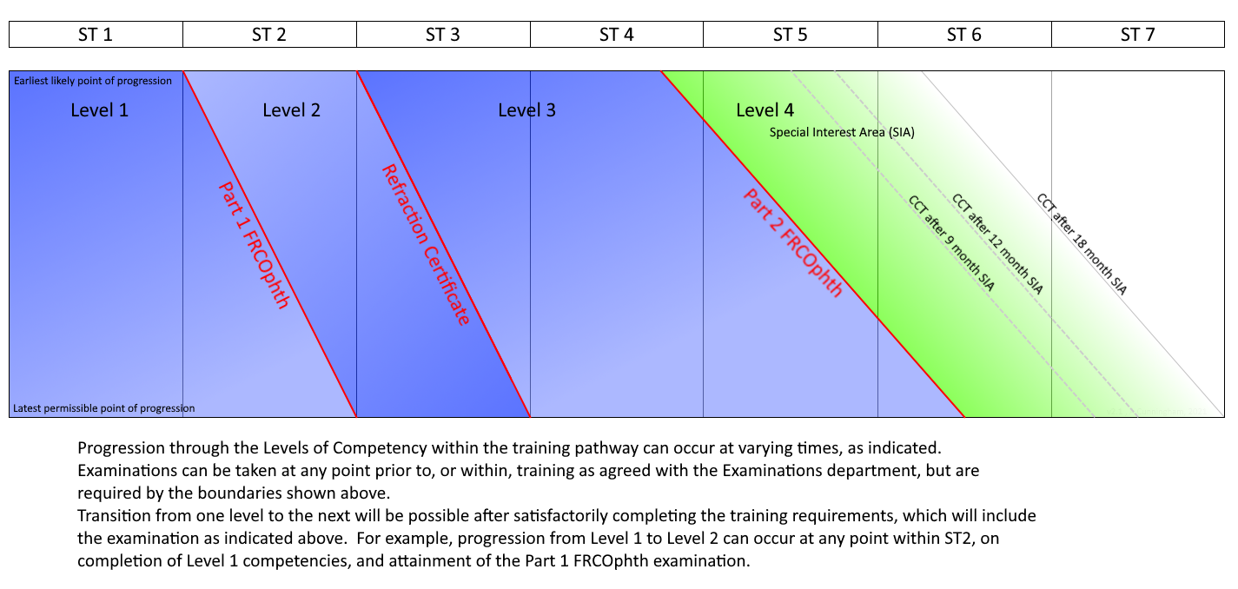
Levels of Training

Slide 7
Level Definitions
Level 1 – management of low complexity patients
basic competence
Level 2 – management of low complexity patients at appropriate rate
independent management of simple cases
Level 3 – management of moderate complexity patients and surgical treatment of low complexity patients
standard of Consultant not specialising in that area
Level 4 – management of uncertainty & complexity of specialty patients
standard of a specialist Consultant

Slide 8
7 Domains in CURRICULUM 2024
Patient Management
Health Promotion
Leadership & Team Working
Patient Safety & Quality Improvement
Safeguarding & Holistic Patient Care
Education & Training
Research & Scholarship
TWELVE Special Interest Areas (SIAs)
Oculoplastics and Orbit
Cornea and Ocular Surface Disease
Cataract Surgery
Glaucoma
Uveitis
Medical Retina
Vitreoretinal Surgery
Ocular Motility
Neuro-ophthalmology
Paediatric Ophthalmology
Urgent Eye Care
Community Ophthalmology

Slide 9
Domains and Levels
Domains | Level 1 | Level 2 | Level 3 | Level 4
Patient Management (12) | x | x | x | Minimum TWO special interest areas
Health Promotion | x | x | x | x
Leadership & Team Working | x | x | x | x
Patient Safety & Quality Improvement | x | x | x | x
Safeguarding & Holistic Patient Care | x | x | x | x
Education & Training | x | x | x | x
Research & Scholarship | x | x | x | x

Slide 10
Layout of Curriculum
LEVEL
Learning outcomes
Descriptors
Domains

Slide 11
Levels 1 and 2
Level 1 must be achieved by end of ST2
Level 2 must be achieved by end of ST3
Majority of trainees will achieve Level 1 and 2 training by the end of ST2 (but this may be variable and is not necessary)
All Level 2 training must be completed by the end of ST3
Skills are basic and spread across all SIAs
Trainees do not have to rotate through all SIAs to gain Level 1 and 2 competencies

Slide 12
Level 3
Level 3 training is current level of ‘sub-specialty’ training for CCT (now Special Interest Area or SIA)
Twelve SIAs – Cataract Surgery, Urgent Eye Care and Community Ophthalmology will not need a dedicated posting and competencies will be acquired simultaneously
Level 3 will range between 2.5 to 3.5 years
Level 3 competencies need to be achieved by a maximum of 5.5 years of training

Slide 13
Level 4
Minimum of TWO Level 4 SIAs need to be completed for CCT
Level 4 entry criteria
FRCOphth Part 2
Level 3 in all SIA and all Generic Skills
Level 4 entry criteria for Cornea & Ocular Surface, Glaucoma and Vitreoretinal Surgery
As above
PLUS Competencies of Level 4 Cataract Surgery
OVER 90 PERCENT OF DEANERIES HAVE ALREADY INDICATED THAT THEY WILL BE ABLE TO PROVIDE LEVEL 4 TRAINING IN ALL 12 SIAs

Slide 14
Autumn Webinar Series
Wednesday 6 September 2023 at 6.30pm: Curriculum 2024 - a refresher
https://us02web.zoom.us/meeting/register/tZUtc-uhrD8iH9Urmq8JG8W-iFkMLsBBNb-7
Tuesday 26 September 2023 at 6.30pm: Managing the transition
https://us02web.zoom.us/meeting/register/tZAsf-GhrT8tGdXgTUufG799A3tBgcL3eh7X
Monday 16 October 2023 at 6.30pm: Introducing the New Assessments
https://us02web.zoom.us/meeting/register/tZEqce2uqjMuEtICHtF53LwOCKgsdarrUNDO
Wednesday 1 November 2023 at 6.30pm: The New ePortfolio
https://us02web.zoom.us/meeting/register/tZckc-6sqzssG9YsJzd9uh4q5KU7o3XnACPP
Tuesday 21 November 2023 at 6.30pm: Levels 1-4 - practical implications
https://us02web.zoom.us/meeting/register/tZUocOmrqTgrG9JysutGLGAKZlLTiVXcHkJX
Monday 11 December 2023 at 6.30pm: Trainer-Trainee interactions in C2024
https://us02web.zoom.us/meeting/register/tZEpf-msrTsuHtfXALhSx011Y-yYEv0sTomp

Slide 15
Curriculum Transition
Current ST Year (August 2023) | ST Year in August 2024 | Change to New Curriculum in AUG ‘24 | MINIMUM Level of Training in August 2024
ST 1 | ST 2 | YES | Midway Level 1
ST 2 | ST 3 | YES | Start of Level 2
ST 3 | ST 4 | YES | Start of Level 3
ST 4 | ST 5 | YES | Level 3: 1.5 years left
ST 5 | ST 6 | OPTIONAL | Level 3: 6 months left

Slide 16
Transition Tool
Will I be entering Level 3 in the new curriculum?
OR
Will I be entering Level 4 and need to check I am eligible for the new curriculum?
YES
NO
CURRICULUM
TRANSITION
SCHEDULE
Have I already got specialities signed off in the old curriculum?
YES
NO
Please indicate X below under “fully signed off” and specify the placement
Not at all
Have I had a placement in this speciality but not been signed off?
Please indicate X below under “partly met” and specify what is outstanding
I have no experience.
Please indicate X below under “no experience”.
How much time do I have left until I am expected to start Level 4? Do I need to request placements in these specialities/alert my ES/ARCP panel?
https://www.rcophth.ac.uk/wp-content/uploads/2023/08/Implementation-Note-7-Level-3-sign-off-2.docx

Slide 17
Autumn Webinar Series
Wednesday 6 September 2023 at 6.30pm: Curriculum 2024 - a refresher
https://us02web.zoom.us/meeting/register/tZUtc-uhrD8iH9Urmq8JG8W-iFkMLsBBNb-7
Tuesday 26 September 2023 at 6.30pm: Managing the transition
https://us02web.zoom.us/meeting/register/tZAsf-GhrT8tGdXgTUufG799A3tBgcL3eh7X
Monday 16 October 2023 at 6.30pm: Introducing the New Assessments
https://us02web.zoom.us/meeting/register/tZEqce2uqjMuEtICHtF53LwOCKgsdarrUNDO
Wednesday 1 November 2023 at 6.30pm: The New ePortfolio
https://us02web.zoom.us/meeting/register/tZckc-6sqzssG9YsJzd9uh4q5KU7o3XnACPP
Tuesday 21 November 2023 at 6.30pm: Levels 1-4 - practical implications
https://us02web.zoom.us/meeting/register/tZUocOmrqTgrG9JysutGLGAKZlLTiVXcHkJX
Monday 11 December 2023 at 6.30pm: Trainer-Trainee interactions in C2024
https://us02web.zoom.us/meeting/register/tZEpf-msrTsuHtfXALhSx011Y-yYEv0sTomp

Slide 18
Assessments - what’s NEW?
Entrustable Professional Assessment (EPA)
key method of assessing the patient management domains; will replace the current clinical supervisor report (CSR)
Completed by Named Clinical Supervisor
Multi-Assessor Reports (MAR)
clinical assessments from other clinicians and professionals; will feed into the EPA
Generic Skills Assessment Tool (GSAT)
key method to assess all the other six generic domains

Slide 19
Assessments - what will GO?
No Clinical Supervisor Reports (replaced by EPA)
Many WpBAs will not be mandatory
No mandatory number of CbDs
No specified numbers for logbook
Modified and simplified ESR and MSF

Slide 20
Autumn Webinar Series
Wednesday 6 September 2023 at 6.30pm: Curriculum 2024 - a refresher
https://us02web.zoom.us/meeting/register/tZUtc-uhrD8iH9Urmq8JG8W-iFkMLsBBNb-7
Tuesday 26 September 2023 at 6.30pm: Managing the transition
https://us02web.zoom.us/meeting/register/tZAsf-GhrT8tGdXgTUufG799A3tBgcL3eh7X
Monday 16 October 2023 at 6.30pm: Introducing the New Assessments
https://us02web.zoom.us/meeting/register/tZEqce2uqjMuEtICHtF53LwOCKgsdarrUNDO
Wednesday 1 November 2023 at 6.30pm: The New ePortfolio
https://us02web.zoom.us/meeting/register/tZckc-6sqzssG9YsJzd9uh4q5KU7o3XnACPP
Tuesday 21 November 2023 at 6.30pm: Levels 1-4 - practical implications
https://us02web.zoom.us/meeting/register/tZUocOmrqTgrG9JysutGLGAKZlLTiVXcHkJX
Monday 11 December 2023 at 6.30pm: Trainer-Trainee interactions in C2024
https://us02web.zoom.us/meeting/register/tZEpf-msrTsuHtfXALhSx011Y-yYEv0sTomp

Slide 21
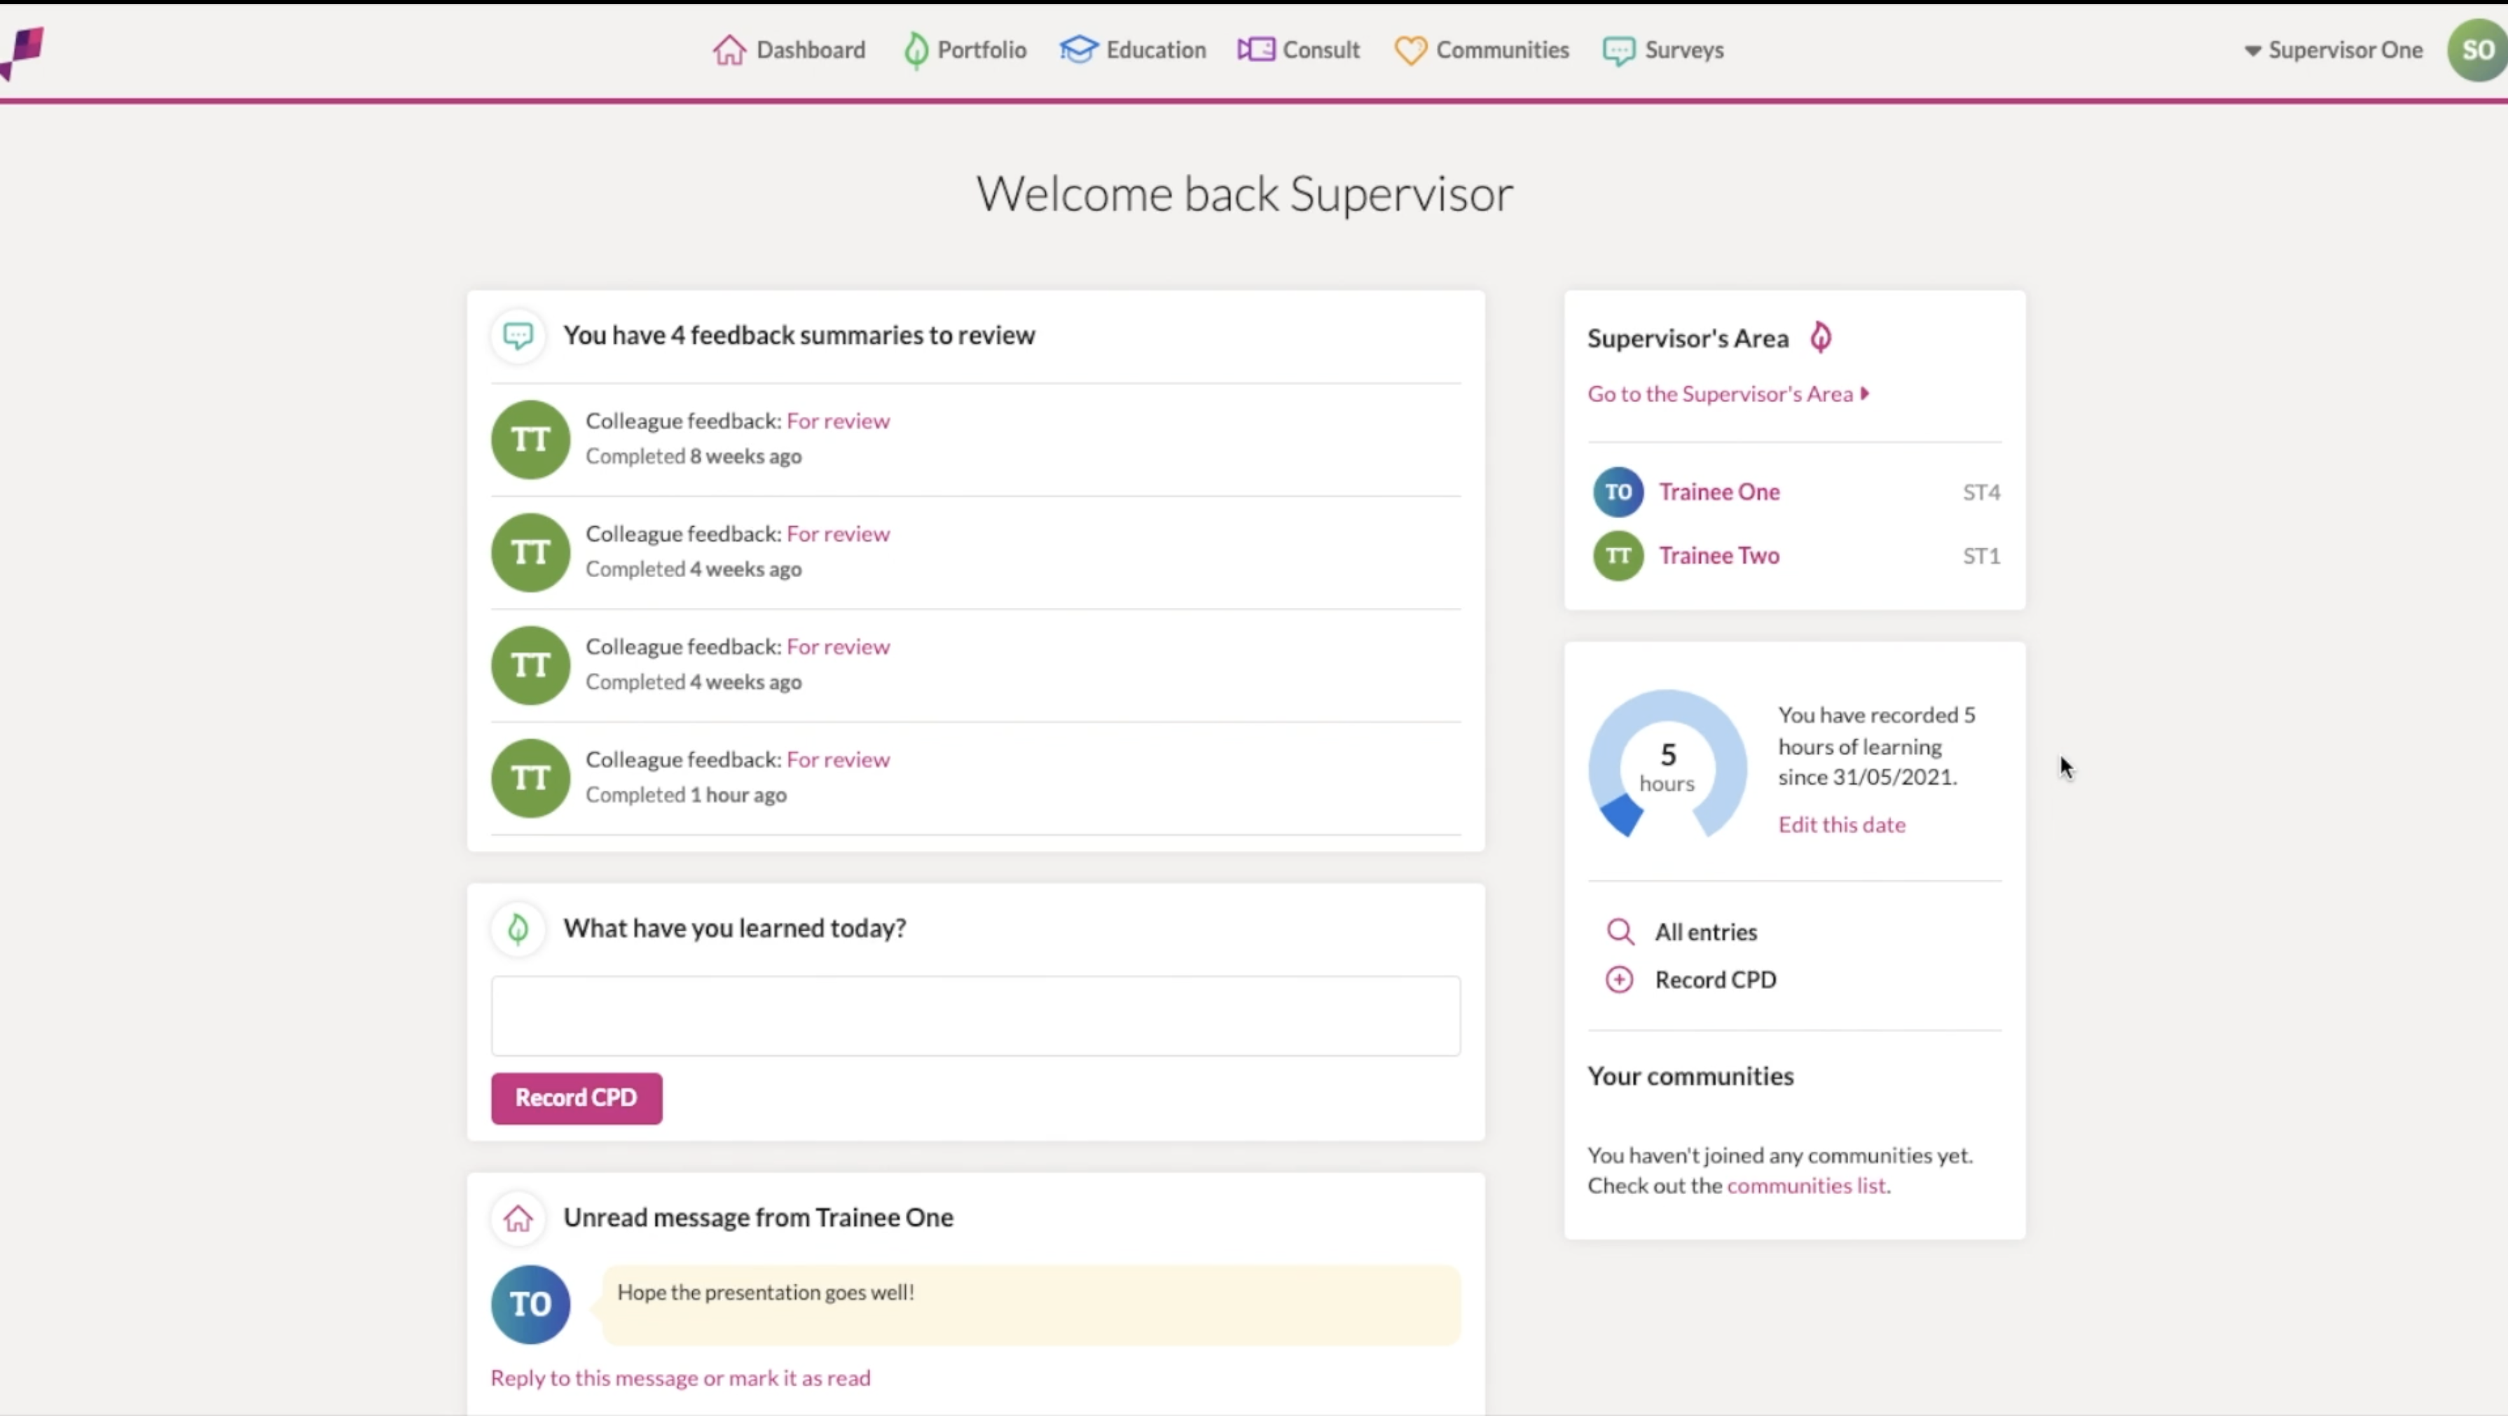
New ePortfolio
Trainees will not be able to use the old ePortfolio from 1 July 2024
All data will be migrated to the new e-portfolio
New ePortfolio will cater for current curriculum until August 2026
Functionality for non-trainee ophthalmologists to accumulate evidence for CESR

Slide 22
Autumn Webinar Series
Wednesday 6 September 2023 at 6.30pm: Curriculum 2024 - a refresher
https://us02web.zoom.us/meeting/register/tZUtc-uhrD8iH9Urmq8JG8W-iFkMLsBBNb-7
Tuesday 26 September 2023 at 6.30pm: Managing the transition
https://us02web.zoom.us/meeting/register/tZAsf-GhrT8tGdXgTUufG799A3tBgcL3eh7X
Monday 16 October 2023 at 6.30pm: Introducing the New Assessments
https://us02web.zoom.us/meeting/register/tZEqce2uqjMuEtICHtF53LwOCKgsdarrUNDO
Wednesday 1 November 2023 at 6.30pm: The New ePortfolio
https://us02web.zoom.us/meeting/register/tZckc-6sqzssG9YsJzd9uh4q5KU7o3XnACPP
Tuesday 21 November 2023 at 6.30pm: Levels 1-4 - practical implications
https://us02web.zoom.us/meeting/register/tZUocOmrqTgrG9JysutGLGAKZlLTiVXcHkJX
Monday 11 December 2023 at 6.30pm: Trainer-Trainee interactions in C2024
https://us02web.zoom.us/meeting/register/tZEpf-msrTsuHtfXALhSx011Y-yYEv0sTomp

Slide 23
TIMELINE
AUG 2023
ST 1-5 discuss proposed Level of Training at point of entry to Curriculum 2024 and complete CURRICULUM TRANSITION SCHEDULE with Educational Supervisors
AUTUMN 2023
NEW assessments are finalised and put on the new ePortfolio
WINTER 2023
ePortfolio Pilot Programme continues
AUG 2024
Curriculum 2024 LAUNCHED
All trainees entering ST6 in August 2024 must inform HoS if they are intending to remain on the old curriculum from August 2024
Series of WEBINARS on Curriculum 2024
ePortfolio Pilot Programme begins
Training Package for Named Clinical Supervisors and Educational Supervisors developed
Assessment Handbook and Level Guides finalized and published
ePortfolio Pilot Programme concludes

Slide 24
More Information
Curriculum 2024 website
https://www.rcophth.ac.uk/training/ophthalmic-specialist-training/ost-curriculum/curriculum-2024/
Curriculum 2024 email
curriculum2024@rcophth.ac.uk
Regional Curriculum Network
- Each region represented by TPD and trainee champion

