Slide 1
MANAGING THE TRANSITION
Vikas Chadha
Chair, Curriculum Subcommittee

Slide 2
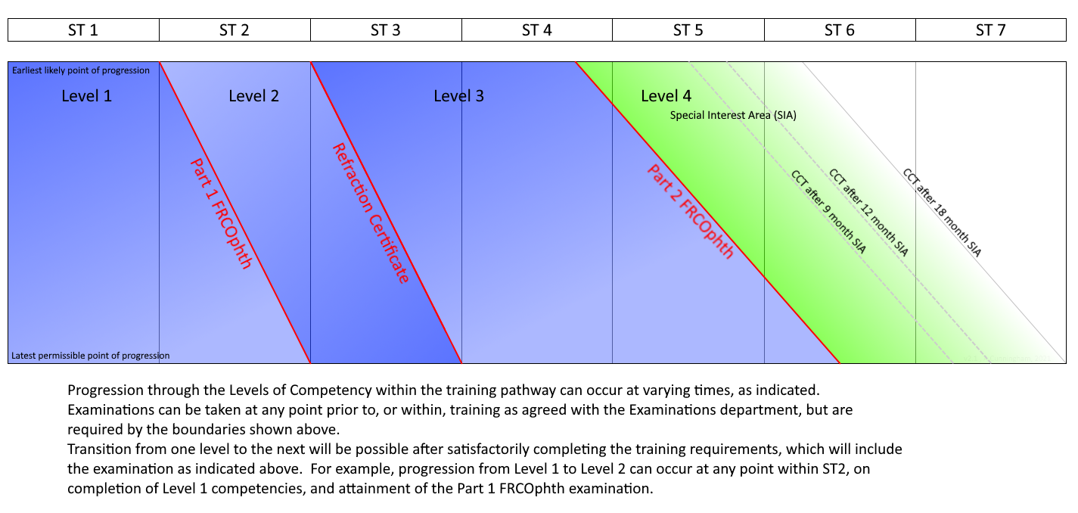
Levels of Training

Slide 3
Who transitions?
Current ST Year (August 2023) | ST Year in August 2024 | Change to New Curriculum in AUG ‘24 | MINIMUM Level of Training in August 2024
ST 1 | ST 2 | YES | Level 1- max 1 year left
ST 2 | ST 3 | YES | Start of Level 2
ST 3 | ST 4 | YES | Start of Level 3
ST 4 | ST 5 | YES | Level 3- max 1.5 yrs left
ST 5 | ST 6 | OPTIONAL | Level 3- max 6 mths left
ST 6 | ST 7 | NO | -

Slide 4
OOP/ LTFT/ Academic trainees
CCT Date | Curriculum in AUG ‘24
Before 6 August 2025 | Stay in OLD curriculum
Between 6 August 2025 and 5 August 2026 | OPTIONAL- can move to new curriculum
After 5 August 2026 | Have to move to NEW curriculum

Slide 5
7 Domains in CURRICULUM 2024
Patient Management
Health Promotion
Leadership & Team Working
Patient Safety & Quality Improvement
Safeguarding & Holistic Patient Care
Education & Training
Research & Scholarship
TWELVE Special Interest Areas (SIAs)
Oculoplastics and Orbit
Cornea and Ocular Surface Disease
Cataract Surgery
Glaucoma
Uveitis
Medical Retina
Vitreoretinal Surgery
Ocular Motility
Neuro-ophthalmology
Paediatric Ophthalmology
Urgent Eye Care
Community Ophthalmology

Slide 6
Progress to Level 2 in Aug 2024
Completed full-time ST2 by August 2024 = Completion of Level 1
Outcome 1 in ARCP 2024
if an adverse outcome has been awarded previously, it should be discussed on an individual basis with the TPD
Includes passing FRCOphth Part 1
If any trainee wishes to progress to Level 2 before completing ST2, transition checklists for Level 1 (all domains) need to be completed and signed off by ES

Slide 7
Progress to Level 3 in Aug 2024
Completed full-time ST3 by August 2024 = Completion of Level 2
Outcome 1 in ARCP 2024
if an adverse outcome has been awarded previously, it should be discussed on an individual basis with the TPD
Includes passing Refraction Certificate
If any trainee wishes to progress to Level 3 before completing ST3, transition checklists for Level 2 (all domains) need to be completed and signed off by ES

Slide 8
Completion of Level 3
Patient management domain- All TWELVE SIAs need to be completed
PLUS
Six Generic Domains (Non- patient management) need to be completed
PLUS
Part 2 FRCOphth Exam

Slide 9
Completion of Level 3 components
9 SIAs (except Cataract, Urgent Eye Care, Community Ophthalmology)
Completed and be signed off for that SIA by the Clinical Supervisor in CSR
Confirmed by Educational Supervisor
Awarded Outcome 1 at the end of that training year in which that SIA was completed (if different outcome- individual case to be assessed by ES and TPD)
Three SIAs (Cataract, Urgent Eye Care, Community Ophthalmology)
PLUS Six Generic Domains (Non- patient management)
Transition checklist to be completed by trainee
Signed off by Educational Supervisor

Slide 10
Example Case 1
Trainee X is an ST4 in 2023-24 and is posted in Oculoplastics from August 2023 to February 2024, and Cornea from February 2024 to August 2024.
Signed off by the Cornea Clinical Supervisor as not needing further cornea training before CCT
Oculoplastics Clinical Supervisor feels that further training in oculoplastics is required
Awarded Outcome 1 in the ARCP held in June 2024.
Trainee will be considered to have completed Cornea Level 3.
Need to identify the deficiencies in oculoplastics training according to Level 3 of Curriculum 2024 and either spend further time in oculoplastics or use the RSTAC to gain those competencies.
Will not be able to progress to Level 4 until all Level 3 competencies are gained.

Slide 11
Example Case 2
Trainee Y is an ST5 in 2023-24 and wants to start Level 4 in Medical Retina and Cataract in august 2024 in the new curriculum
Trainee is posted in Glaucoma from August 2023 to February 2024, and Vitreo-retina from February 2024 to August 2024
Gets signed off in Glaucoma and VR during these postings
Has already been signed off in Cornea, Oculoplastics, Medical retina, Uveitis, Neuro-ophthalmology, Ocular motility and Paediatric Ophthalmology (SEVEN SIAs) by the CS in previous postings
Needs Outcome 1 in the ARCP held in June 2024.
Needs to complete Level 3 Transition checklists for Cataract, Community Ophthalmology and Urgent Eye Care
Needs to complete Level 3 Transition checklist for Six generic domains
Can start Level 4 if regional logistics allow, training opportunities for other trainees are not compromised and patient safety is not at risk

Slide 12
ST Year in August 2024 | Desired Level in August 2024 | Conditions
ST 2 | Level 1 | Nil; Has maximum 1 further year to complete Level 1
ST 2 | Level 2 | Needs to complete transition checklists for Level 1; FRCOphth Part 1 exam
ST 3 | Level 2 | Outcome 1; FRCOphth Part 1 exam
ST 3 | Level 3 | Needs to complete transition checklists for Level 2; Refraction certificate
ST 4 | Level 3 | Outcome 1; Refraction certificate
ST 4/ 5 | Level 3 partly completed | SIAs signed off by CS will be considered completed; Checklists for other SIAs + Six Generic Domains
ST 5 | Level 4 | Nine SIAs signed off by CS; Three SIAs checklist completed; Six Generic domains checklist completed; Part 2 exam

Slide 13
Tool
Will I be entering Level 3 in the new curriculum?
OR
Will I be entering Level 4 and need to check I am eligible for the new curriculum?
YES
NO
Curriculum Transition
Schedule
Have I already got specialities signed off in the old curriculum?
YES
NO
Please indicate X below under “fully signed off” and specify the placement
Not at all
Have I had a placement in this speciality but not been signed off?
Please indicate X below under “partly met” and specify what is outstanding
I have no experience.
Please indicate X below under “no experience”.
How much time do I have left until I am expected to start Level 4? Do I need to request placements in these specialities/alert my ES/ARCP panel?

Slide 14
ACTION
ES and trainee to discuss the anticipated level at which trainee will enter Curriculum 2024 in Aug’24
Inform TPD by 30th August 2023
Trainee to work towards that goal and keep ES informed of progress

