Slide 1
ASSESSMENTS in
CURRICULUM 2024
Vikas Chadha
Chair of Curriculum Sub-committee

Slide 2
What are we assessing?
Patient Management
Health Promotion
Leadership & team working
Patient Safety & Quality Improvement
Safeguarding & Holistic patient care
Education & Training
Research & Scholarship
Oculoplastics and Orbit (i)
Cornea and Ocular Surface (ii)
Cataract Surgery (iii)
Glaucoma (iv)
Uveitis (v)
Medical Retina (vi)
Vitreoretinal Surgery (vii)
Ocular Motility (viii)
Neuro-ophthalmology (ix)
Paediatric Ophthalmology (x)
Urgent Eye Care (xi)
Community Ophthalmology (xii)

Slide 3
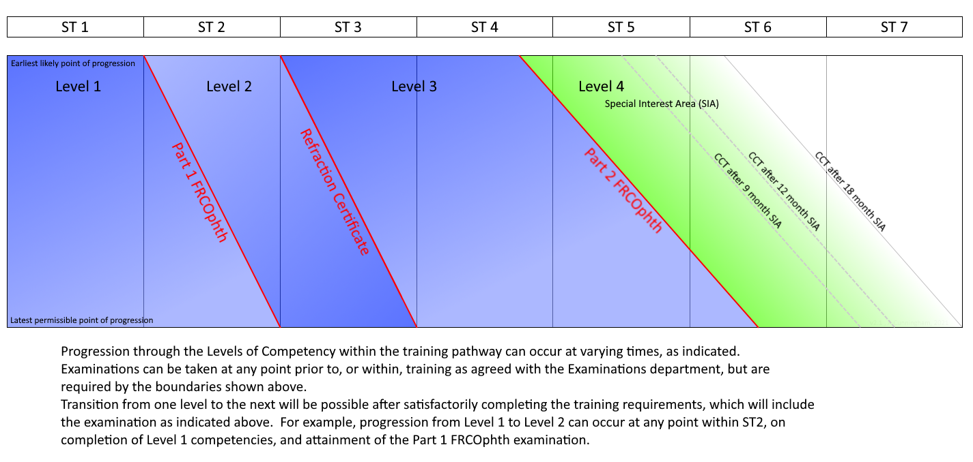
When are we assessing?

Slide 4
New Assessments
Entrustable Professional Activity (EPA)
key method of assessing the patient management domains; will replace the current clinical supervisor report (CSR)
One for Level 1, 2; Twelve for Level 3; Two out of twelve for Level 4
Multi-Assessor Reports (MAR)
clinical assessments from other clinicians and professionals; will feed into the EPA
Generic Skills Assessment Tool (GSAT)
key method to assess all the other domains
One for each Level

Slide 5
EPA
ENTRUSTABLE PROFESSIONAL ACTIVITY
Longitudinal look a trainee’s clinical practice and then indication whether they are an entrustable clinician to their level or not
Looks at clinical and surgical skills, management decisions, team work and some mandatory WpBAs dependent on level
Essentially, is the trainee clinically (and surgically) on-track for their level?
Have they covered the mandated assessments?

Slide 6
EPA
At least ONE every SIX months
Levels 1 and 2 will have ONE every six months
Levels 3 and 4 may have more than one every six months as there is a separate EPA for every SIA in these levels
EPA is completed by trainee and the NAMED CLINICAL SUPERVISOR
Only ONE named clinical supervisor responsible for each EPA
Replaces CURRENT Clinical Supervisor Report

Slide 7
MAR
MULTI-ASSESSOR REPORTS
One universal form, not specific to any Level
Who are these Assessors?
- All other Consultants trainee is working with in the week
- Senior trainees or Consultants with whom trainee was on-call or did an eye casualty/ acute referral clinic
- Any other appropriate clinicians/ orthoptists/ optometrists
- Determined by Named Clinical Supervisor and Trainee

Slide 8
GSAT
GENERIC SKILLS ASSESSMENT TOOL
ONE assessment form covers all SIX generic domains for ONE Level
Trainee-driven:- Trainee fills in the entire form and adds on the evidence for each domain
Responsibility of Educational Supervisor to sign off
ONE every SIX months

Slide 9
EXAMPLES
EPA- Example for Level 1
MAR
GSAT- Example for Level 2
NB- Formatting of all these forms will look very different on the new e-portfolio

Slide 10
Assessments- What will STAY?
ESR
Educational supervisor's report remains the main piece of evidence; Form modified- simpler and more intuitive
MSF
Form modified- reduced number of questions, less onerous
WpBAs
Only SOME will be mandatory, rest optional

Slide 11
Assessments- What will GO?
Clinical supervisors reports no longer required (replaced by EPA)
Many WpBAs will not be mandatory
No mandatory number of CBDs
(No specified numbers for logbook)

Slide 12
Who’s who for the Trainee?
Head of School
Training Programme Director
College Tutor
Educational Supervisor - ONE per six months
Named Clinical Supervisor
- One per SIX months for Levels 1 and 2
- One per SIX months per SIA for Levels 3 and 4
Assessors
Current ‘CLINICAL SUPERVISOR’ role will not exist-
converted to either Named Clinical Supervisor or Assessor or Both

Slide 13
Educational Supervisor
Similar to current role but less onerous
Responsible for
- GSAT (Generic skills Assessment Tool)
- ESR (Educational Supervisor Report)
Overall educational supervision of trainee
GSAT- primarily trainee-driven
ESR- simpler and more intuitive

Slide 14
Named Clinical Supervisor
A Consultant working with trainee in the rotation
ONE named clinical supervisor for every six months in Level 1 and Level 2
ONE named clinical supervisor for every SIA every six months for Levels 3 and 4
Responsible for EPA (Entrustable Professional Activity)
Should complete the EPA after consultation with other Consultants in the rotation (Assessors)

Slide 15
Assessors
All other Consultants (apart from the Named Clinical Supervisor) working with trainee in the rotation
Senior trainees or Consultants with whom trainee was on-call
Senior trainees or Consultants with whom trainee has done an ad-hoc clinic/ eye casualty/ acute referral clinic
Any other appropriate clinicians/ orthoptists/ optometrists
The above will be determined by Trainee and NCS
Responsible for MAR (Multi-assessor report) which feeds into the EPA (Entrustable Professional Activity)

Slide 16
ASSESSMENT | HOW MANY? | WHO? | TOOLS USED TO COMPLETE ASSESSMENT
EPA holistic assessment of competency of trainee in a patient-mgmt domain | One every six months for Levels 1 and 2 One for every SIA (Special interest area) in Level 3 One every six months per SIA for Level 4 | Named Clinical Supervisor | Longitudinal observation, MAR (s), mandatory WpBAs, optional WpBAs
MAR clinical assessment from others as all competencies may not have been witnessed by CS | No number specified (will feed into the EPA) | Assessors- Other Consultants or clinicians Other qualified professionals (eg orthoptist, optometrist, nurse practitioner) | Direct observation; Other indirect evidence or feedback
GSAT one form for assessment of competencies for all non-clinical domains | One every six months | Educational Supervisor | Evidence demonstrated by trainee

Slide 17
NEW Assessments
ESR (2/yr)
- educational supervisor
EPA (at least 2/yr)
- named clinical supervisor
MAR(s)
- Assessors (consultants and other clinicians)
Other WpBAs
MSF (1/yr)
GSAT (at least 2/yr)
- educational supervisor
MAR (s)
- Assessors (other professionals)

Slide 18
The HEADLINES
Significantly decreased workload of WpBAS
No mandatory CBDs
One Named Clinical Supervisor for each trainee- therefore decreased number of CSR equivalents (EPA)
Other Consultants working with trainee are Assessors- fill in a much shorter and simpler form (MAR)
Modified ESR- online, simpler, intuitive, embedded data
Generic Skills Assessments (GSAT)- driven by Trainees; will have detailed guidance in Assessment Handbook

