Slide 1
CURRICULUM 2024:
LEVELS 1-3
Vikas Chadha
Chair of Curriculum Sub-committee

Slide 2
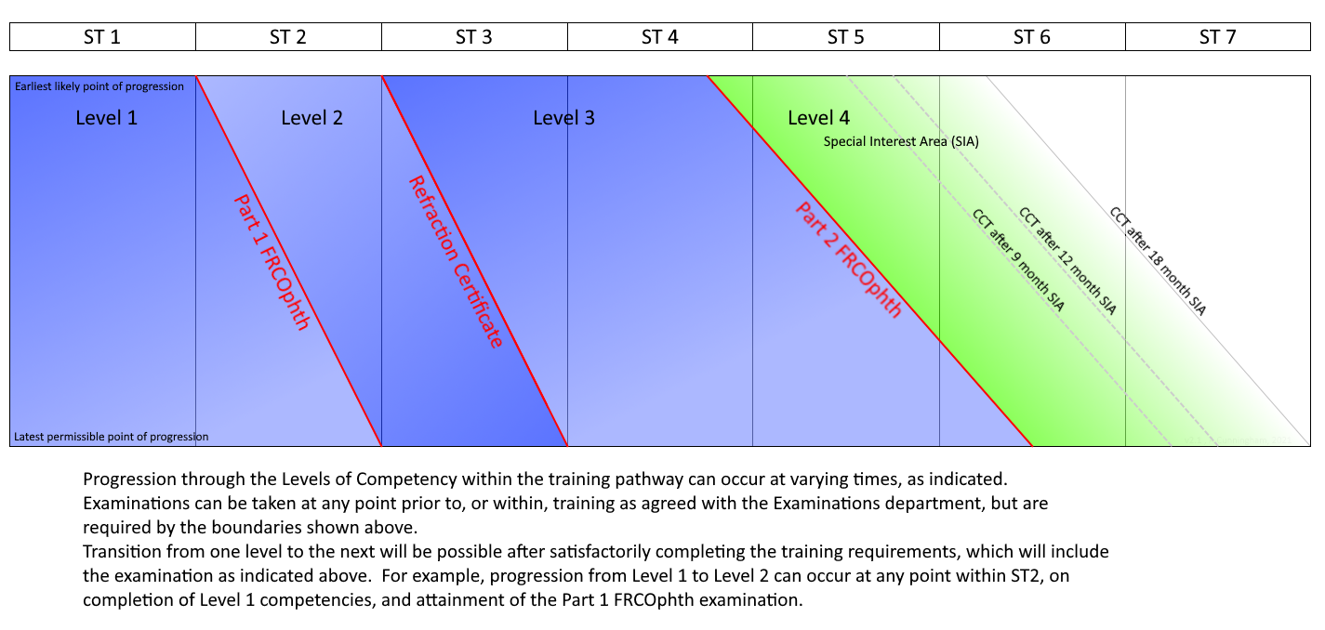
Levels of Training

Slide 3
LEVEL DEFINITIONS
Level 1 – management of low complexity patients
:basic competence
Level 2 – management of low complexity patients at appropriate rate
:independent management of simple cases
Level 3 – management of moderate complexity patients and surgical treatment of low complexity patients
:standard of Consultant not specialising in that area
Level 4 – management of uncertainty & complexity of specialty patients
:standard of a specialist Consultant

Slide 4
Levels 1 and 2
Maximum of 2 years and 1 year respectively
Majority of trainees will achieve Level 1 and 2 training by the end of ST2, but this may be variable (not necessary)
All Level 2 training must be completed by the end of ST3
Skills are basic and spread across all SIAs
Level 1 and 2 competencies will be acquired despite a trainee not having rotated through all SIAs.

Slide 5
Level 1 and 2 Time-tables
General ophthalmology clinics
Emergency/ Urgent Eye Care/ Acute referral Clinics
One cataract list
One RSTAC (plus PGT)

Slide 6
Example- West of Scotland
Level 1 and 2:
All trainees encouraged to complete in TWO years (not mandatory)
Option of extending Level 2 to a maximum of end of ST3
Rotations will have General clinic and increased Acute Referral Clinics
3-month exposure to Paeds and 3-month Cataract immersion training
First two years will not have Neuro/ Oc motility/ VR

Slide 7
Level 3
Level 3 training is current level of ‘sub-speciality’ training for CCT
Twelve SIAs
Cataract, Urgent Eye Care and Community Ophthalmology will not need a dedicated posting; competencies to be acquired simultaneously

Slide 8
Level 3 rotations
Nine SIAs to be completed in 2.5- 3.5 years (depending on how long trainee takes to finish Level 2)
Suggest combining 2 SIAs in some 6-month postings
Examples- Paediatric Ophthalmology and Ocular Motility
Neuro-ophthalmology and Ocular Motility
Medical Retina and Vitreoretinal Surgery
Medical Retina and Uveitis
4-month postings are also an option- LOCAL solutions

Slide 9
Example- West of Scotland
Level 3: SIX- MONTH ROTATIONS
Medical Retina and Uveitis
Ocular motility and Neuro-ophthalmology
Cornea
Glaucoma
Oculoplastics
Vitreo-retina
Paediatric Ophthalmology

Slide 10
Level 3 Time-table
EXAMPLE TIME-TABLE (eg Two SIAs in 6 months)
Two SIA clinics (per SIA)
One SIA theatre list (per SIA as appropriate)
Two RSTACs (plus one PGT)
EXAMPLE- Neuro-ophthalmology and Ocular motility time-table
Example
 | Monday | Tuesday | Wednesday | Thursday | Friday
AM | Ocular Motility clinic | RSTAC | Ocular Motility theatre | Neuro-ophthalmology ciinic | RSTAC
PM | Cataract theatre | Cataract clinic | PGT | Ocular motility clinic | Neuro-ophthalmology ciinic

Slide 11
Levels 1-3: RSTAC
RSTAC
Research, Teaching, Study, Audit, Curriculum competencies
Community ophthalmology competencies
Generic domains (SIX non-patient management domains)
‘Catch-up’ on competencies that may not have been acquired in any previous SIA posting
Trainee (and trainer) directed session; not Trust/ Board directed

Slide 12
Community Ophthalmology
Competencies to be gained using RSTACs
A number of competencies are knowledge based and not practice-based
Details of reading material, links etcetra are available in modules on INSPIRE
Direct link
https://docs.google.com/spreadsheets/d/1Iiw2icnwFuP1al611wzcJqyBVge7oh7_JfM8EhNFTas/edit?usp=sharing

