Slide 3
The new portfolio will have both the old and the new curriculum

Slide 4
Notes:
One issue we had with the old ePortfolio is that the website didn’t really work on mobile devices, well it does now! Whatever screen size you use, the website will adapt and re-order the information to make it easy to navigate on that device. Perfect for using on mobiles and tablets.

Slide 5
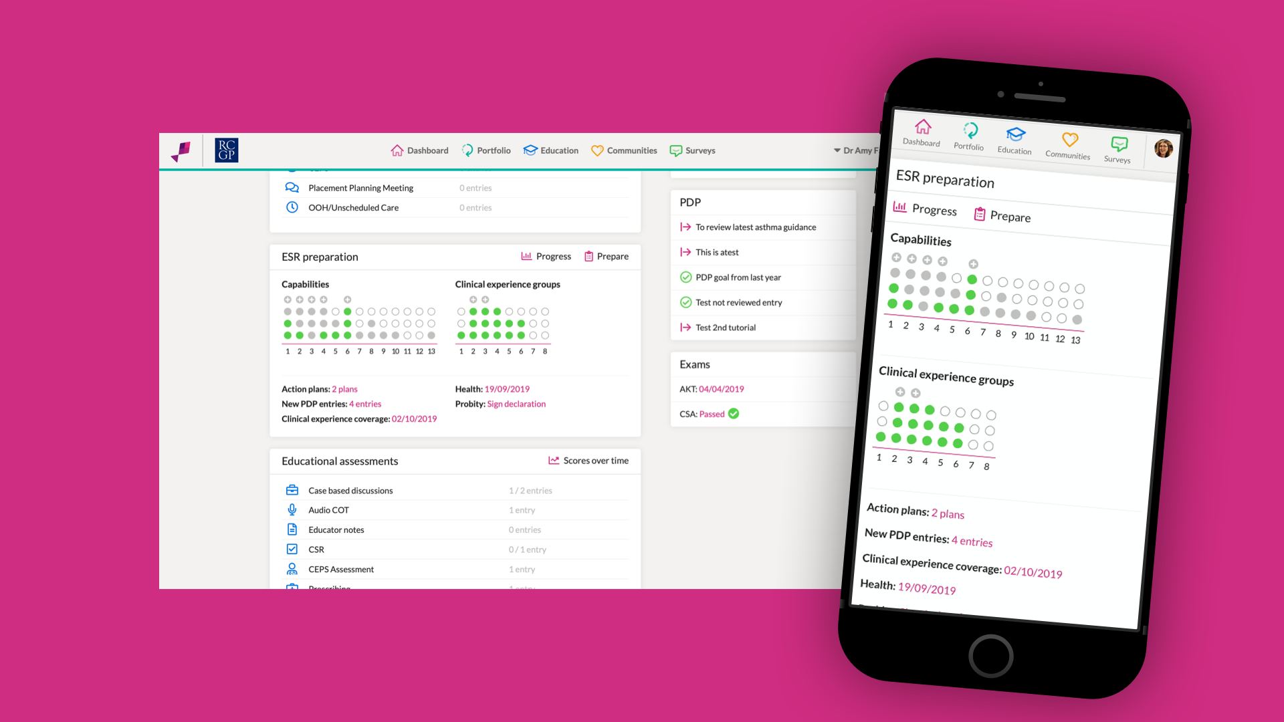

Slide 6
Notes:
Not only is the website dynamic but there is an app for both iOS and Android. This app allows you to write and review all of your log entries both online and offline. If you write a log whilst offline, the next time you connect, everything online will be updated. This app is two ways, so if you write a log entry online, it will appear in the app. The app is not just for writing logs though, you can also link the entries to clinical experience groups and to capabilities.

Slide 7
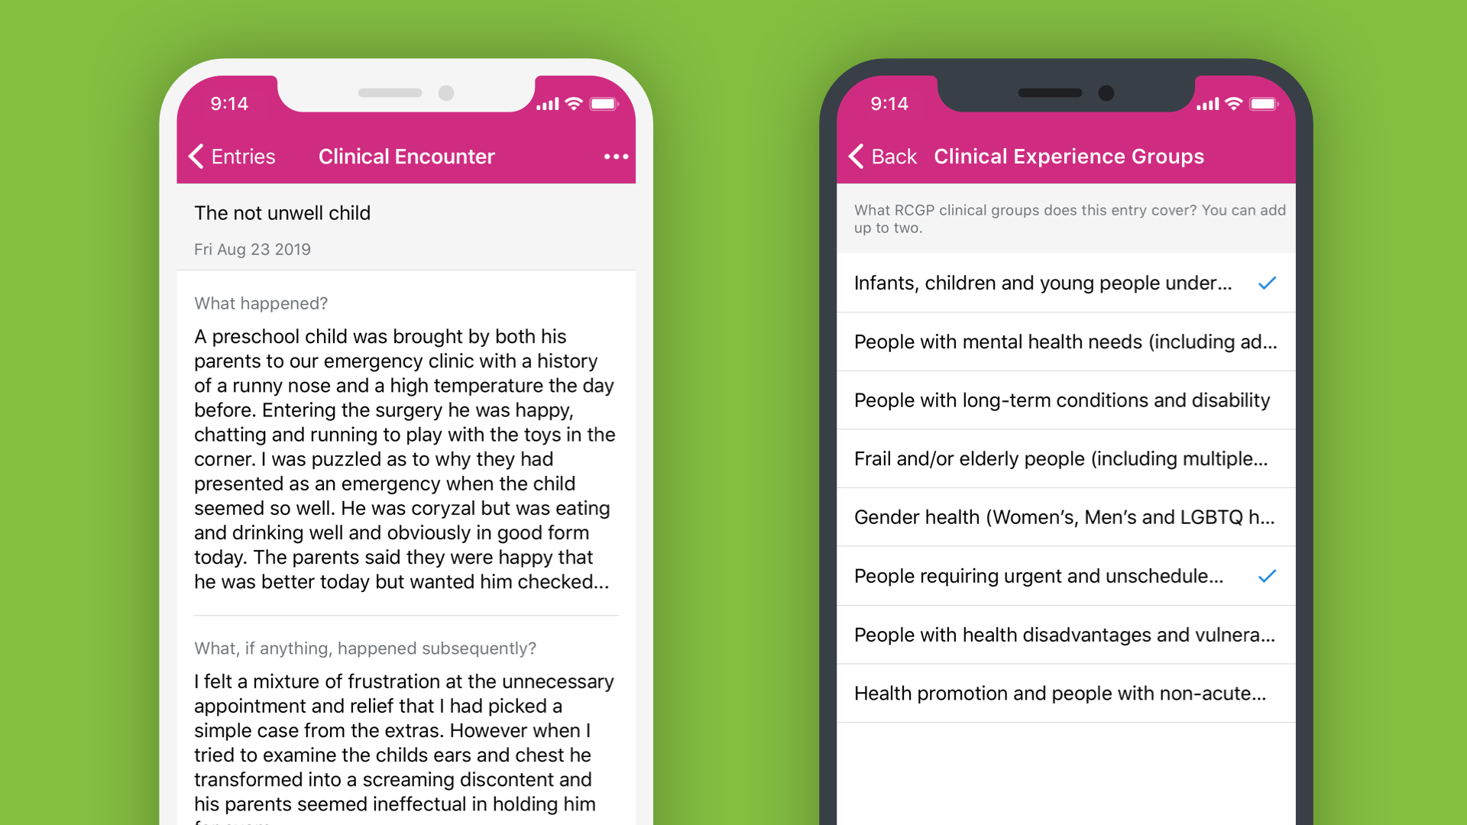

Slide 8
Notes:
The new Portfolio has a fantastic inbuilt messaging service that is easily viewable and with personalised notifications. You can easily see when a message has been read. We imagine this will be used to organise ESRs, prompt trainees on assessments and to discuss tutorial ideas etc.

Slide 10
Notes:
Some trainees struggle to reflect in written form. The new Portfolio will easily allow the trainee to use natural language to write their log entries. This will be a huge benefit to both trainees and trainers. To do this, the website utilises the built in digital assistant on the device the user is using, such as siri. This means that it will be much more accurate as will probably have already learnt the voice of the user. Obviously it won’t know a lot of medical jargon but will pick this up over time.

Slide 11
Notes:
Something that was really important to me was the ability to perform powerful searches, to harvest rich data which could be analysed and hopefully, ultimately, allow evidenced guidance to trainees on where they might need to focus next. The search function can also be used by yourselves to find information you have stored on the portfolio.

Slide 12
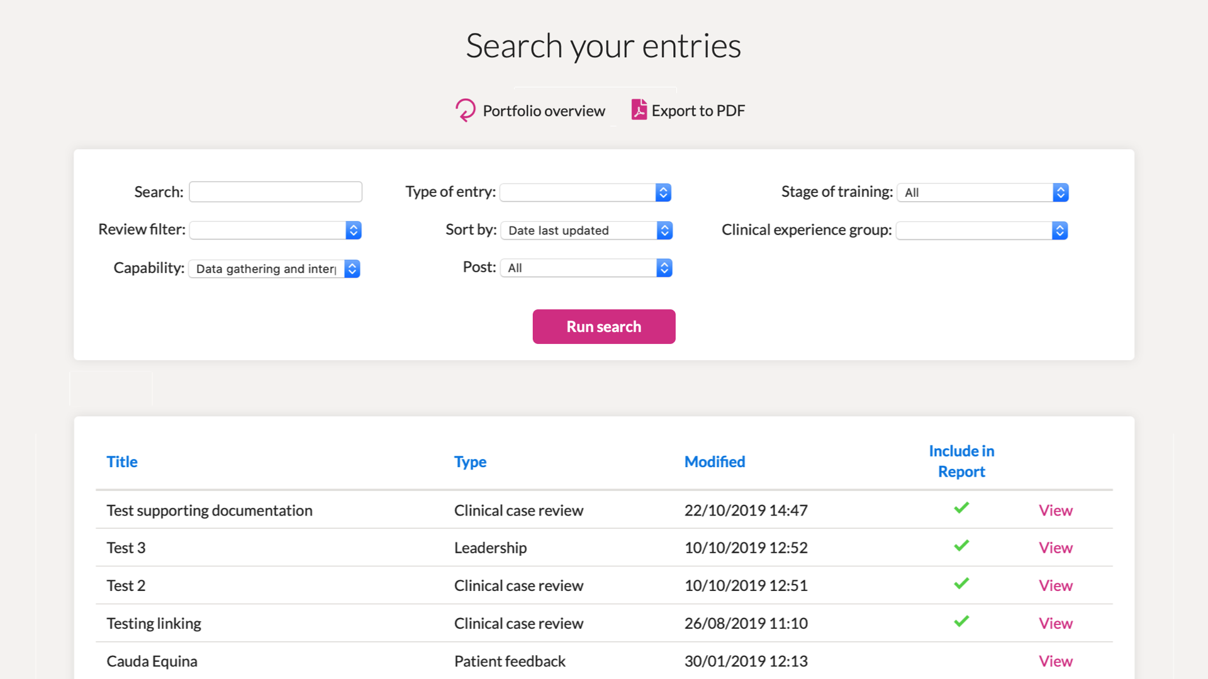

Slide 13
Notes:
At the moment, you are not able to see how you have developed over time with assessments. Moving forwards, we will be able to see multiples of the same assessment to identify improvement but also patterns or areas that might require more attention.

Slide 14
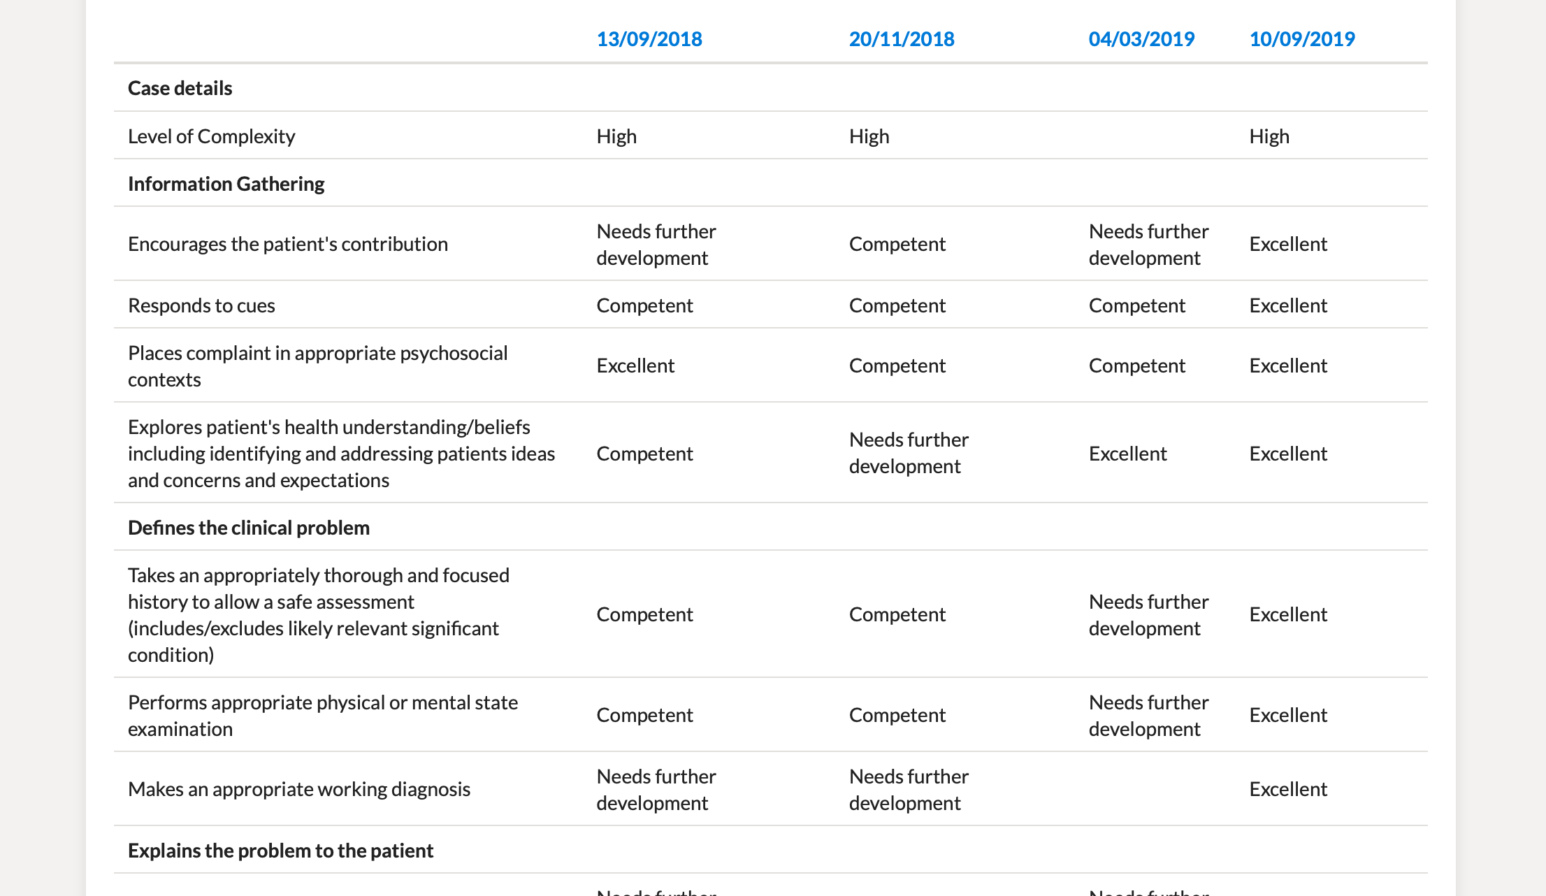

Slide 16
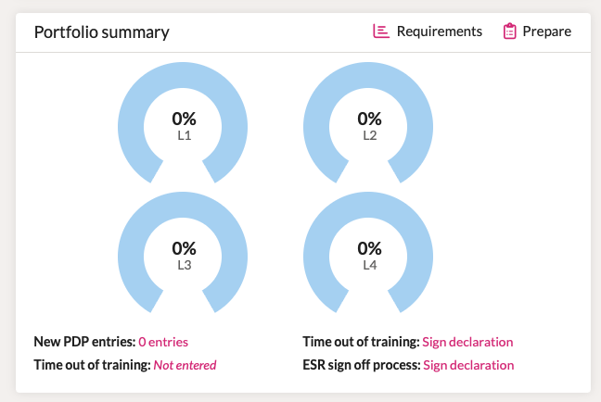
The new portfolio has graphs to track progression against each of the 4 Levels

Slide 17
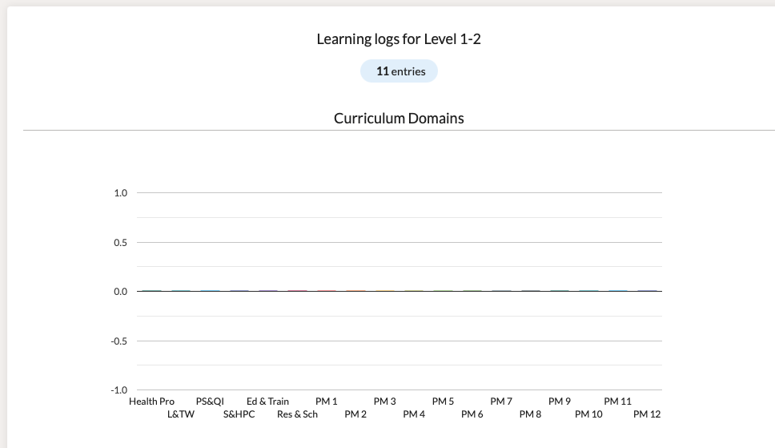

Slide 19
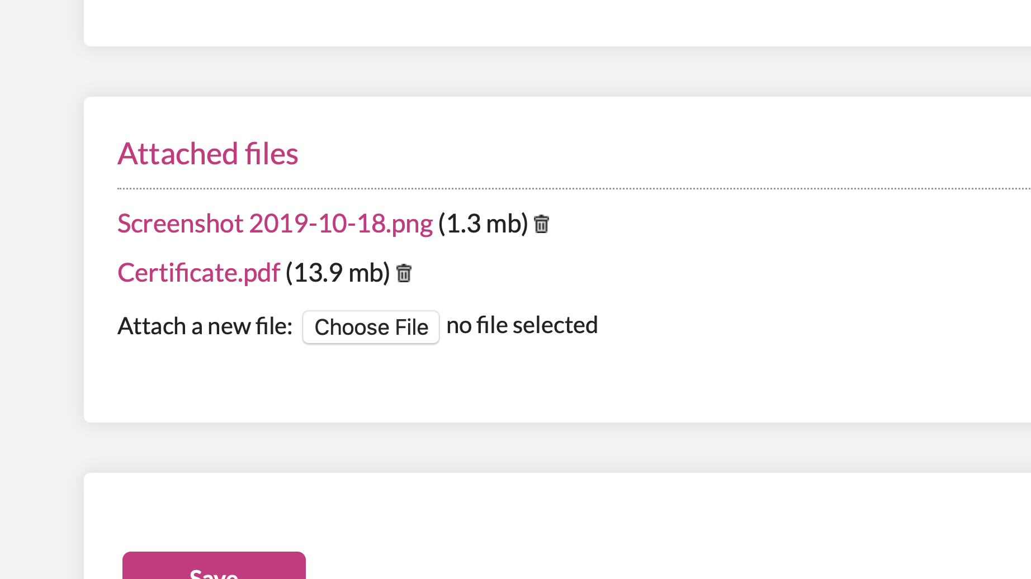

Slide 21
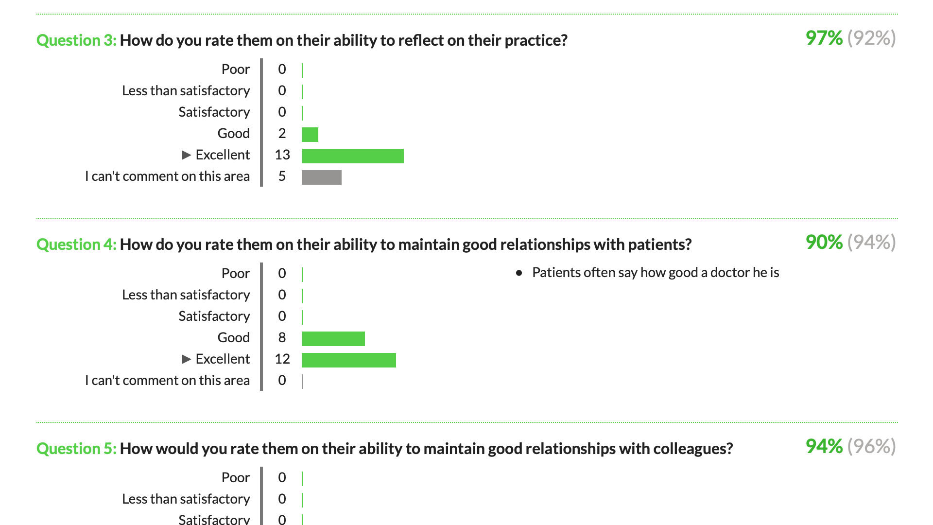

Slide 23
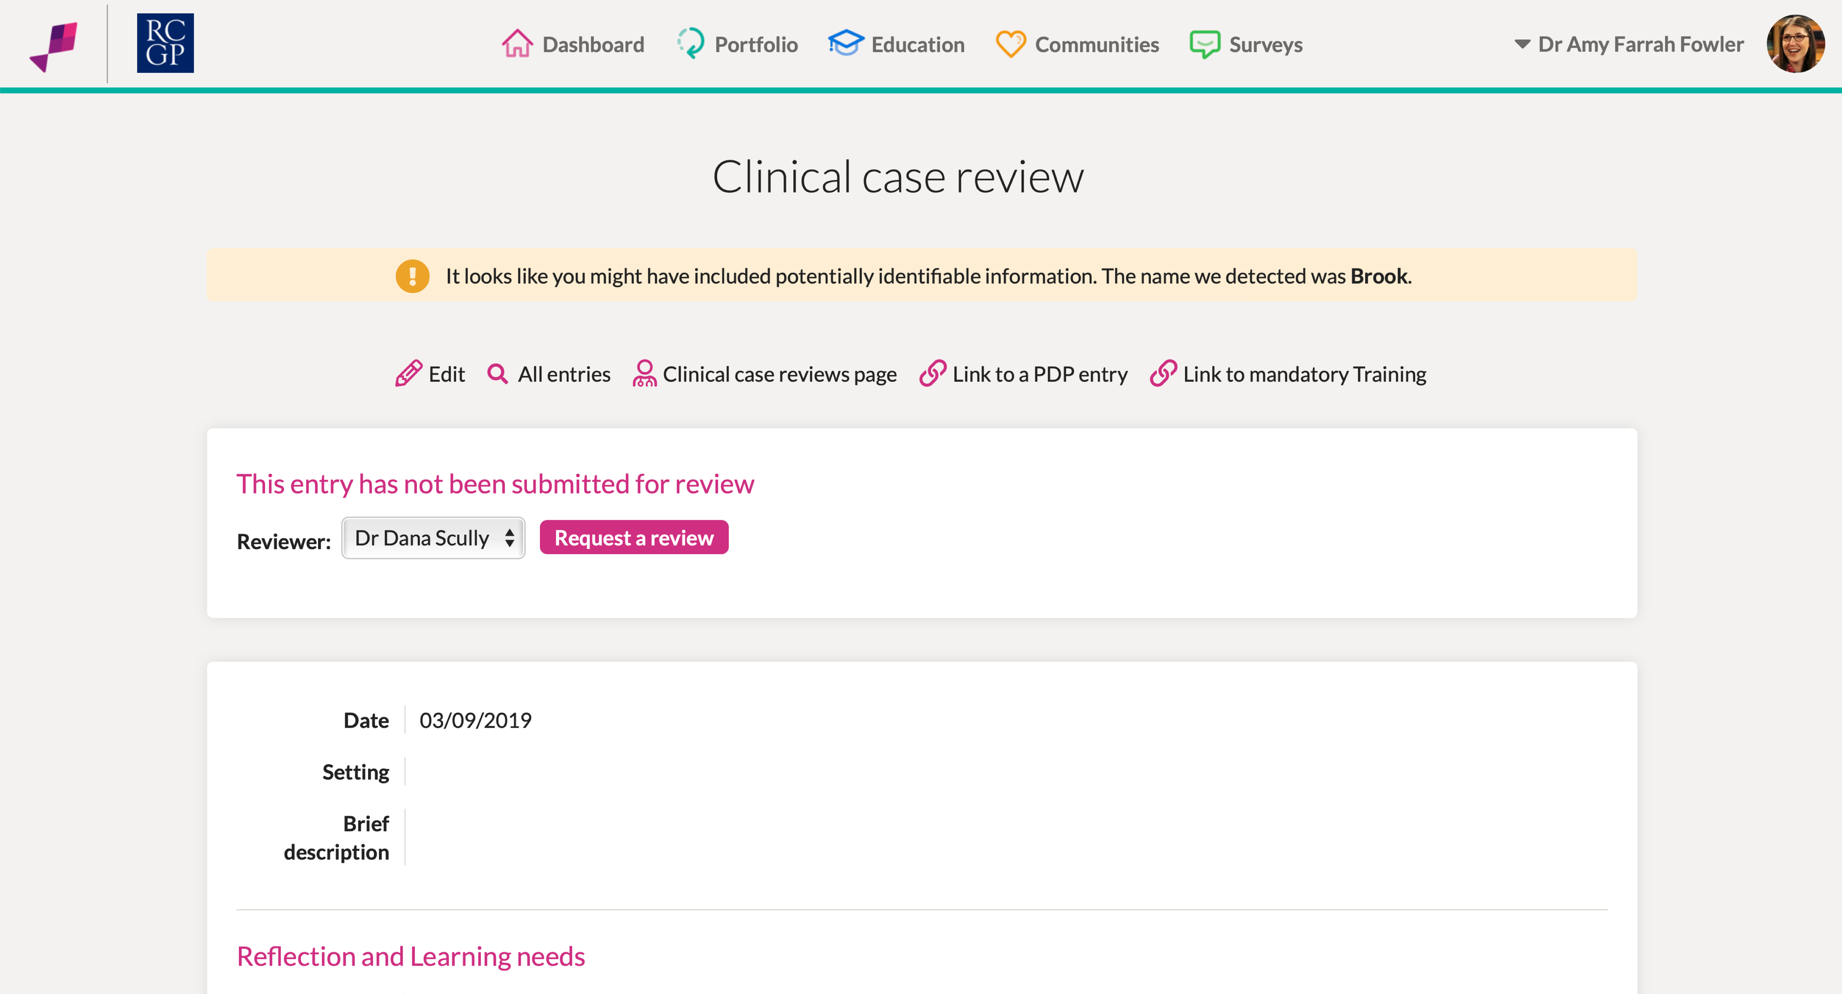

Slide 24
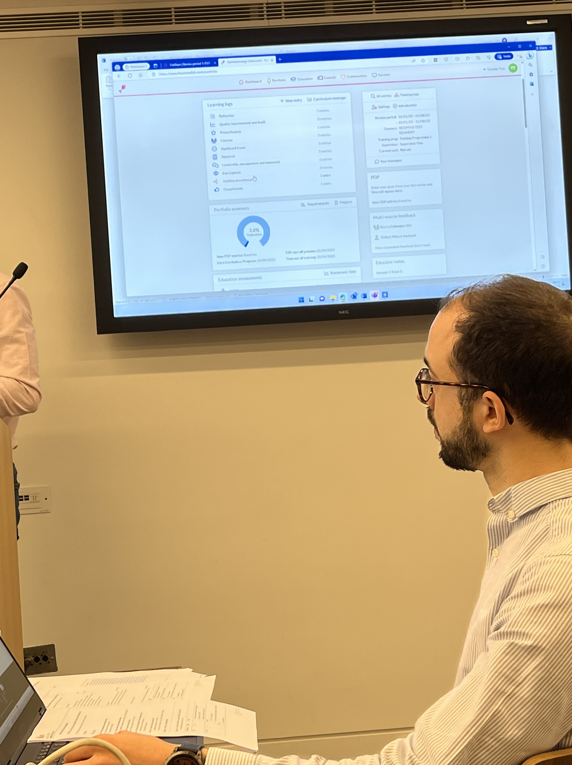
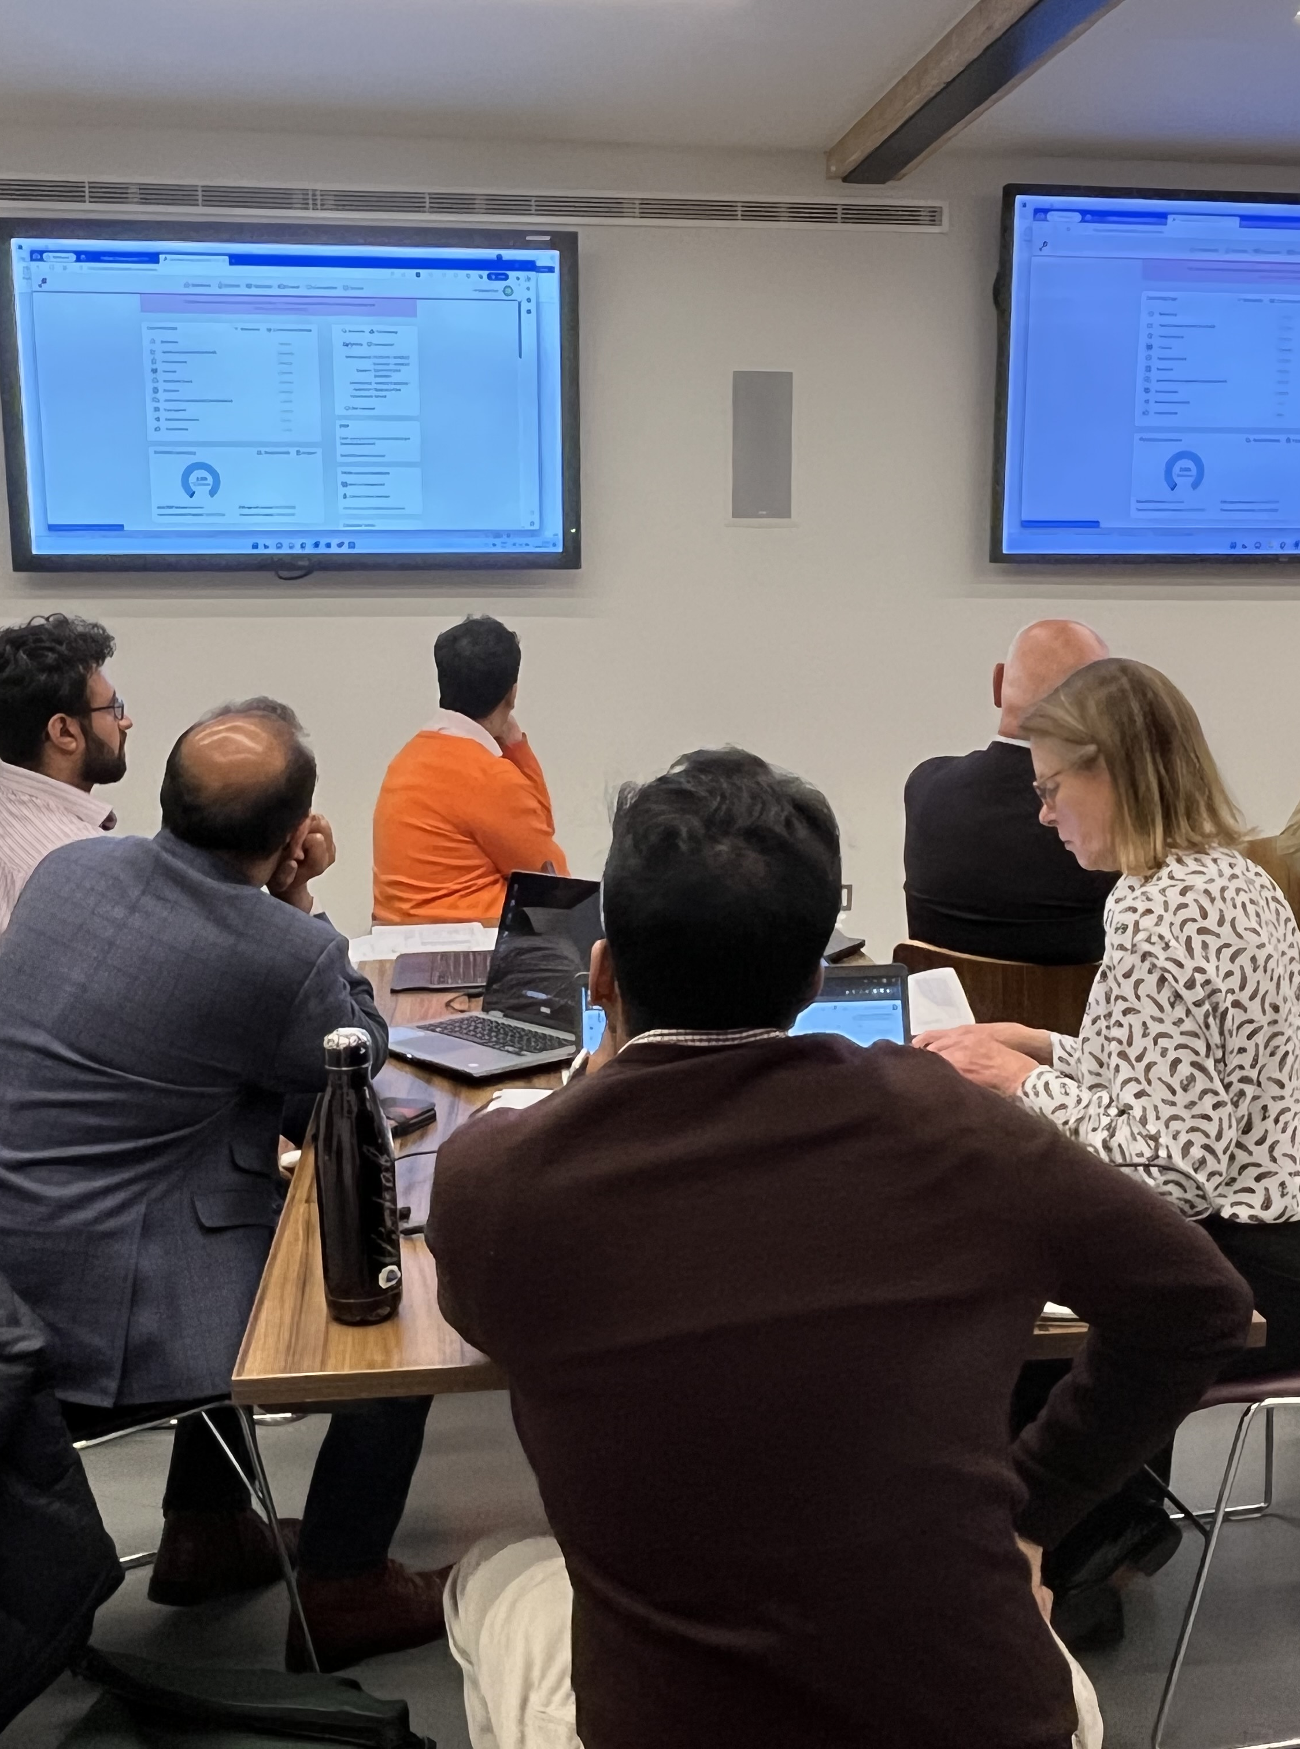
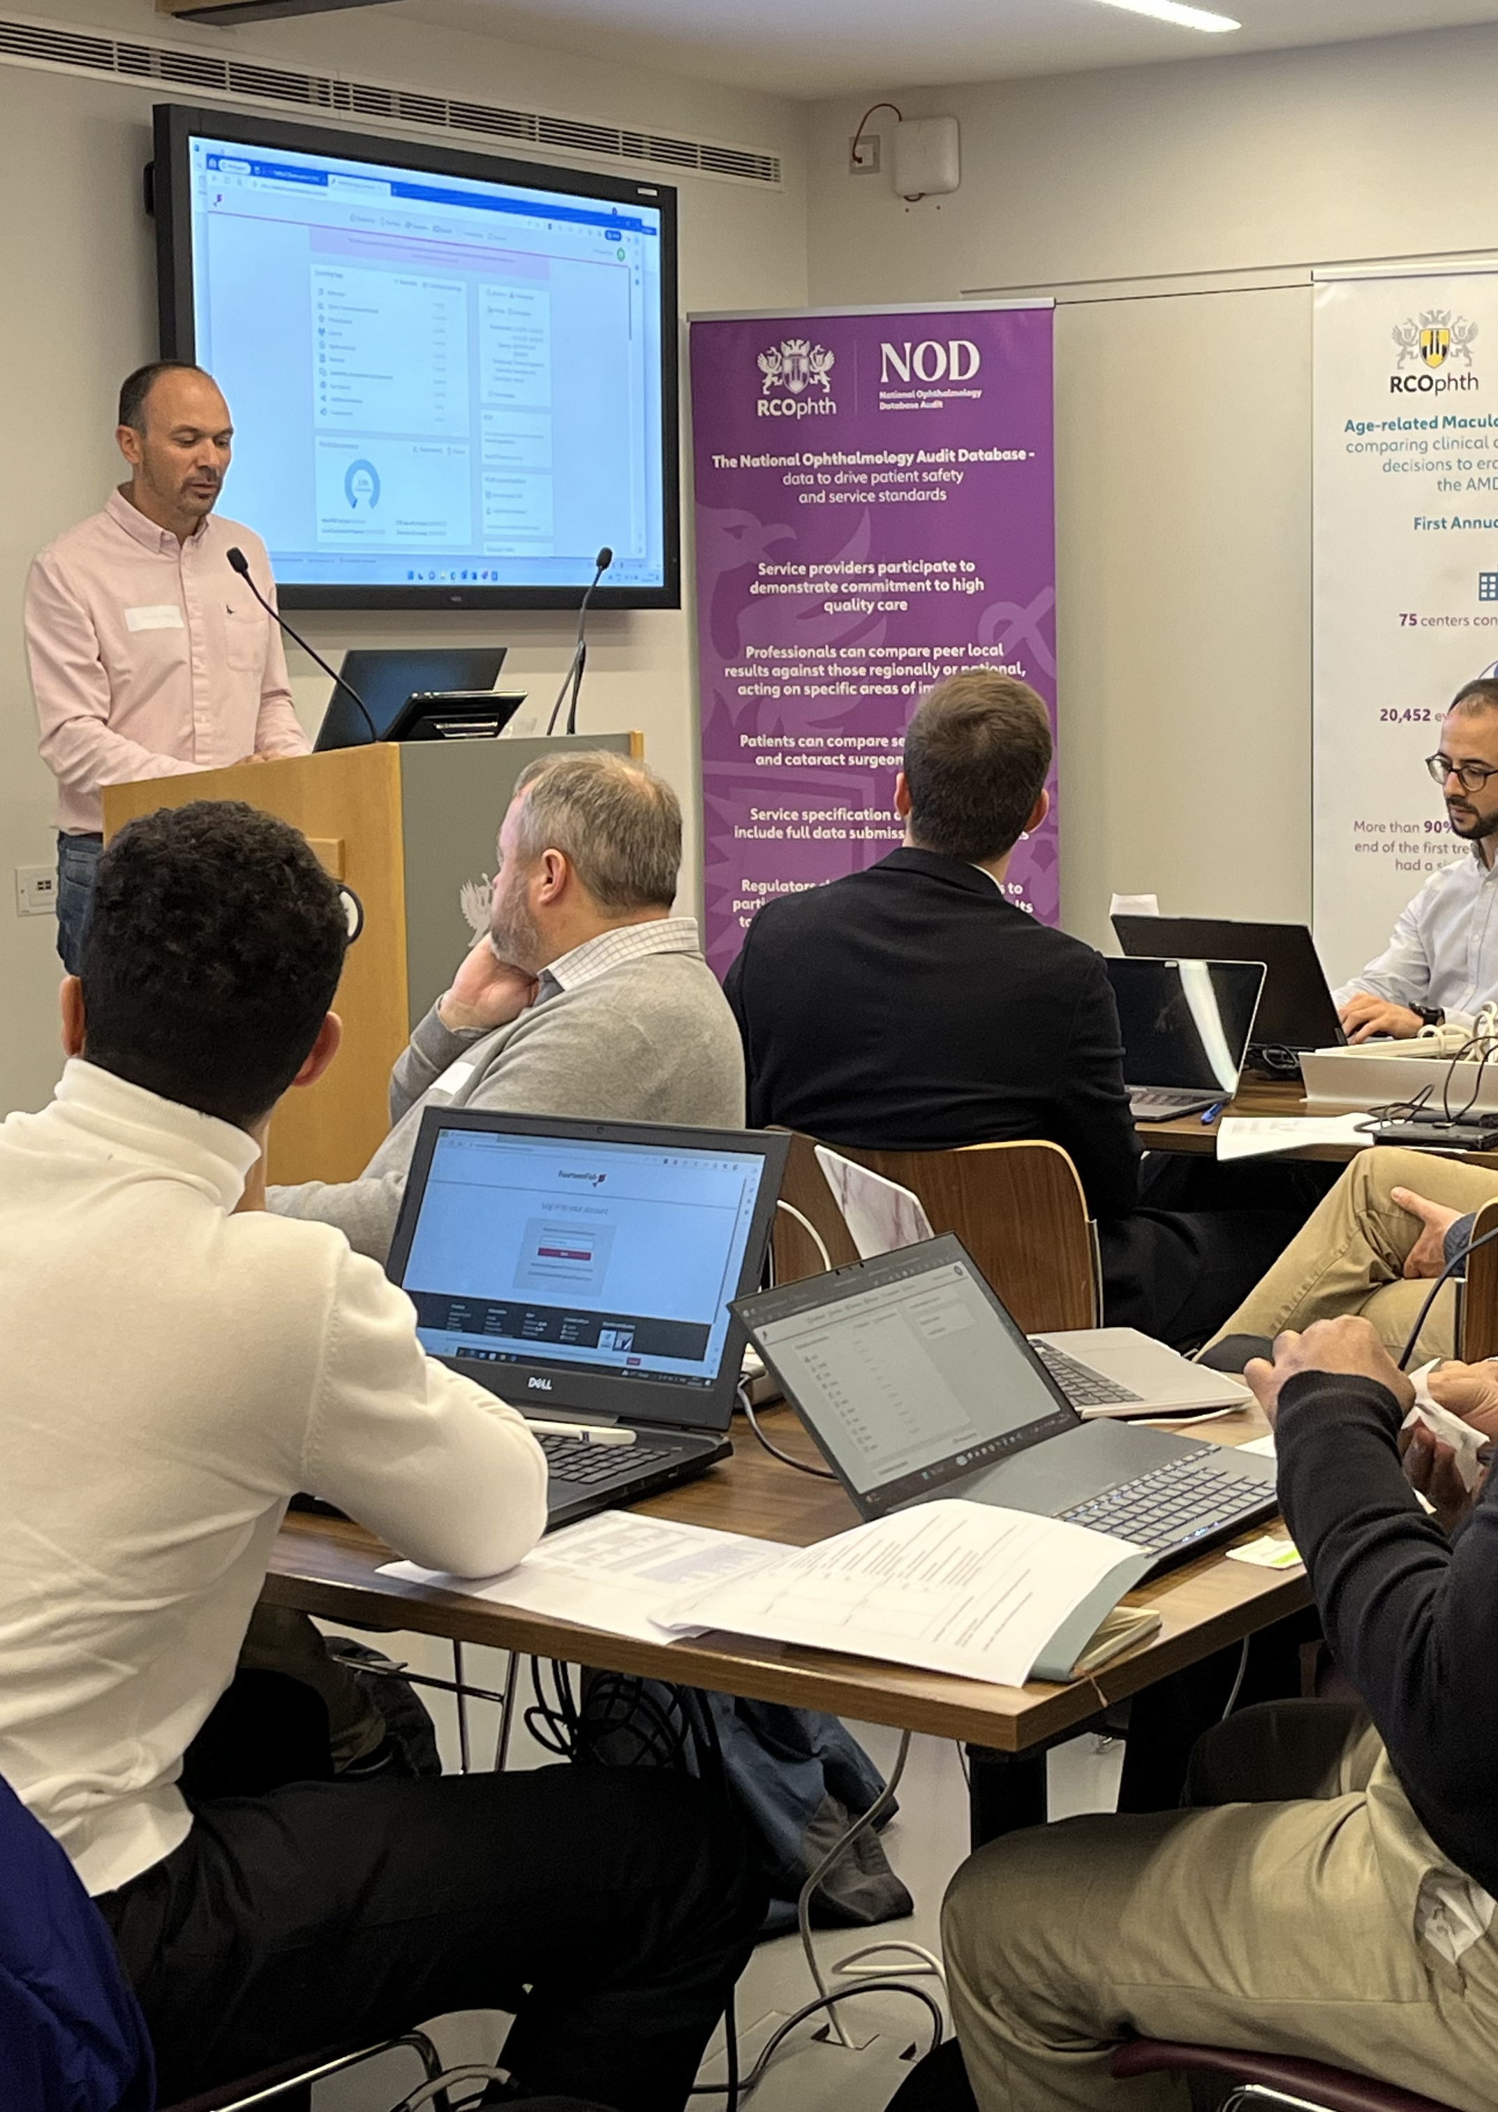
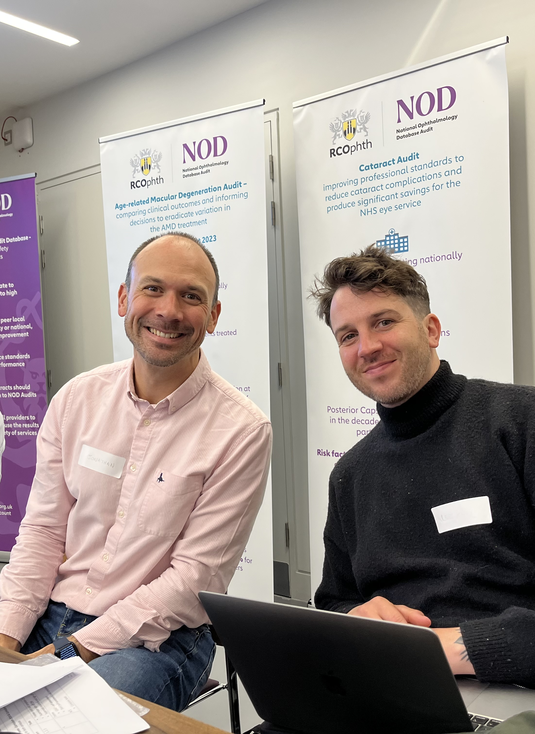
User Acceptance Testing September 2023

Slide 25
Demo

