Slide 1
CURRICULUM 2024:
Trainee- Trainer Interactions
Vikas Chadha
Chair of Curriculum Sub-committee

Slide 2
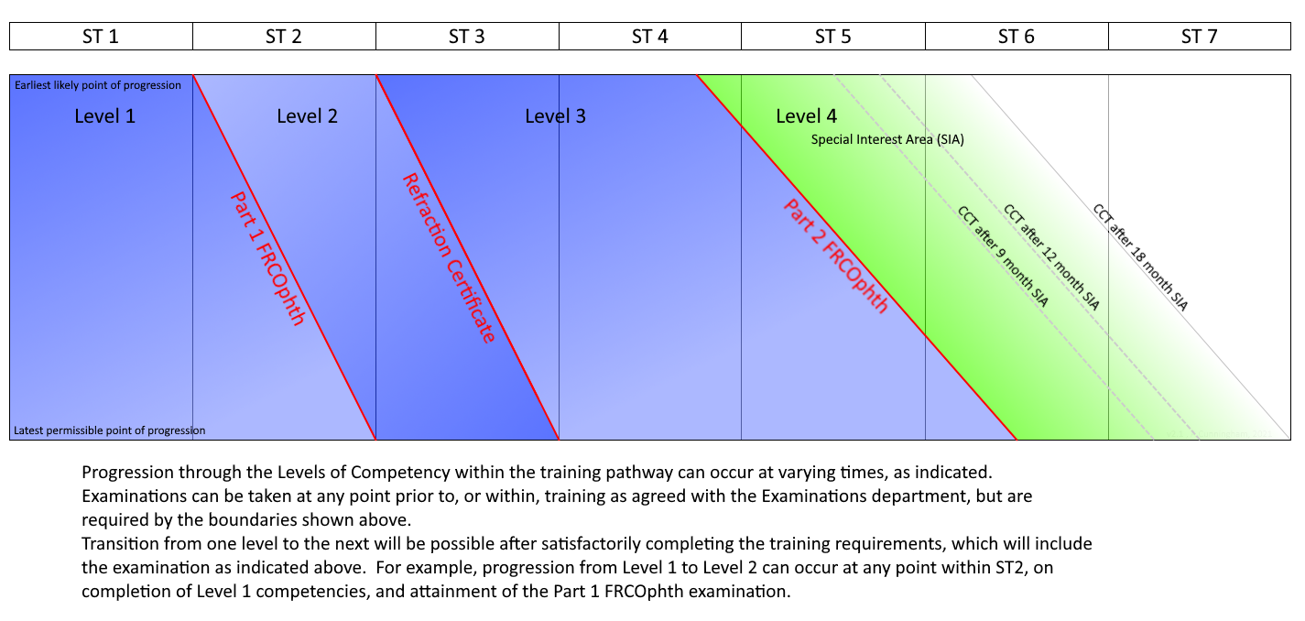
Structure of Training

Slide 3
7 Domains in CURRICULUM 2024
Patient Management
Health Promotion
Leadership & Team Working
Patient Safety & Quality Improvement
Safeguarding & Holistic Patient Care
Education & Training
Research & Scholarship
TWELVE Special Interest Areas (SIAs)
Oculoplastics and Orbit
Cornea and Ocular Surface Disease
Cataract Surgery
Glaucoma
Uveitis
Medical Retina
Vitreoretinal Surgery
Ocular Motility
Neuro-ophthalmology
Paediatric Ophthalmology
Urgent Eye Care
Community Ophthalmology

Slide 4
ASSESSMENTS
Patient Management
TWELVE Special Interest Areas (SIAs)
Oculoplastics and Orbit
Cornea and Ocular Surface Disease
Cataract Surgery
Glaucoma
Uveitis
Medical Retina
Vitreoretinal Surgery
Ocular Motility
Neuro-ophthalmology
Paediatric Ophthalmology
Urgent Eye Care
Community Ophthalmology
Entrustable Professional Assessment (EPA)
key method of assessing the patient management domains; will replace the current clinical supervisor report (CSR)
Completed by Named Clinical Supervisor
Multi-Assessor Reports (MAR)
clinical assessments from other clinicians and professionals; will feed into the EPA

Slide 5
Named Clinical Supervisor (NCS)
A Consultant working with trainee in the rotation
ONE named clinical supervisor for every six months in Level 1 and Level 2
ONE named clinical supervisor for every SIA every six months for Levels 3 and 4
Responsible for EPA (Entrustable Professional Activity)
Should complete the EPA after consultation with other Consultants in the rotation (Assessors)

Slide 6
EPA
ENTRUSTABLE PROFESSIONAL ACTIVITY
Longitudinal look a trainee’s clinical practice and then indication whether they are an entrustable clinician to their level or not
Looks at clinical and surgical skills, management decisions, team work and some mandatory WpBAs dependent on level
Essentially, is the trainee clinically (and surgically) on-track for their level?
Have they covered the mandated assessments?

Slide 7
Assessors and MAR
All other Consultants (apart from the Named Clinical Supervisor) working with trainee in the rotation
Senior trainees or Consultants with whom trainee was on-call
Senior trainees or Consultants with whom trainee has done an ad-hoc clinic/ eye casualty/ acute referral clinic
Any other appropriate clinicians/ orthoptists/ optometrists
The above will be determined by Trainee and NCS
Responsible for MAR (Multi-assessor report) which feeds into the EPA (Entrustable Professional Activity)
MAR: One universal form, not specific to any Level

Slide 8
ASSESSMENTS
Health Promotion
Leadership & Team Working
Patient Safety & Quality Improvement
Safeguarding & Holistic Patient Care
Education & Training
Research & Scholarship
Generic Skills Assessment Tool (GSAT)
key method to assess all the other domains
One for each Level

Slide 9
Educational Supervisor
Responsible for
- GSAT (Generic skills Assessment Tool)
- ESR (Educational Supervisor Report)
Overall educational supervision of trainee
GSAT- primarily trainee-driven
ESR- simpler and more intuitive

Slide 10
GSAT
GENERIC SKILLS ASSESSMENT TOOL
ONE assessment form covers all SIX generic domains for ONE Level
Trainee-driven:- Trainee fills in the entire form and adds on the evidence for each domain
Responsibility of Educational Supervisor to sign off
ONE every SIX months

Slide 11
Assessments - what’s NEW?
Entrustable Professional Assessment (EPA)
key method of assessing the patient management domains; will replace the current clinical supervisor report (CSR)
Completed by Named Clinical Supervisor
Multi-Assessor Reports (MAR)
clinical assessments from other clinicians and professionals; will feed into the EPA
Generic Skills Assessment Tool (GSAT)
key method to assess all the other six generic domains

Slide 12
Assessments- What will STAY?
ESR
Educational supervisor's report remains the main piece of evidence; Form modified- simpler and more intuitive
MSF
Form modified- reduced number of questions, less onerous
WpBAs
Only SOME will be mandatory, rest optional

Slide 13
Assessments- What will GO?
Clinical supervisors reports no longer required (replaced by EPA)
Many WpBAs will not be mandatory
No mandatory number of CBDs
(No specified numbers for logbook)

Slide 14
Who’s who for the Trainee?
Head of School
Training Programme Director
College Tutor
Educational Supervisor - ONE per six months
Named Clinical Supervisor
- One per SIX months for Levels 1 and 2
- One per SIX months per SIA for Levels 3 and 4
Assessors
Current ‘CLINICAL SUPERVISOR’ role will not exist-
converted to either Named Clinical Supervisor or Assessor or Both

Slide 15
ESR (2/yr)
- educational supervisor
EPA (at least 2/yr)
- named clinical supervisor
MAR(s)
- Assessors (consultants and other clinicians)
Other WpBAs
MSF (1/yr)
GSAT (at least 2/yr)
- educational supervisor
MAR (s)
- Assessors (other professionals)

Slide 16
Trainee- trainer interactions
Start of Placement
Trainee- Named Clinical Supervisor initial meeting
Trainee- Educational Supervisor initial appraisal meeting
Interim review/s
End of Placement
Trainee- Named Clinical Supervisor meeting
Trainee- Educational Supervisor meeting

Slide 17
Trainee- NCS: initial meeting
Current Level of Training
- including SIAs completed (if Level 3 or 4)
Aimed Level of Training/ completion of SIA
Choose Assessors for MAR
Discuss any difficult to obtain Learning Outcomes
Discuss specific CBDs or other Assessments that the NCS requires

Slide 18
Trainee- NCS: final meeting
End of rotation
Review of MARs
Review of mandatory and other assessments
EPA
- Has the Level or the SIA (for Level 3/4) been achieved?
- If not, what is required?
- Clear indication of evidence needed to sign off Level or SIA

Slide 19
Trainee- ES: initial appraisal meeting
Current Level of Training
Aimed Level of Training at end of rotation
What does the trainee need to get there?
Overall trajectory of training
GSAT review
- includes research and teaching
RSTAC
- specific aims of RSTAC utilisation over the next 6 months
Personal Development Plan

Slide 20
Trainee- ES: final meeting
End of rotation
GSAT
- Has the Level been achieved in all six domains?
- If not, what is required?
EPA review
- Has the NCS signed off that Level or the SIA (for Level 3/4)?
- If not, what is required?
Educational Supervisor Report (including above assessments review and MSF review)

Slide 21
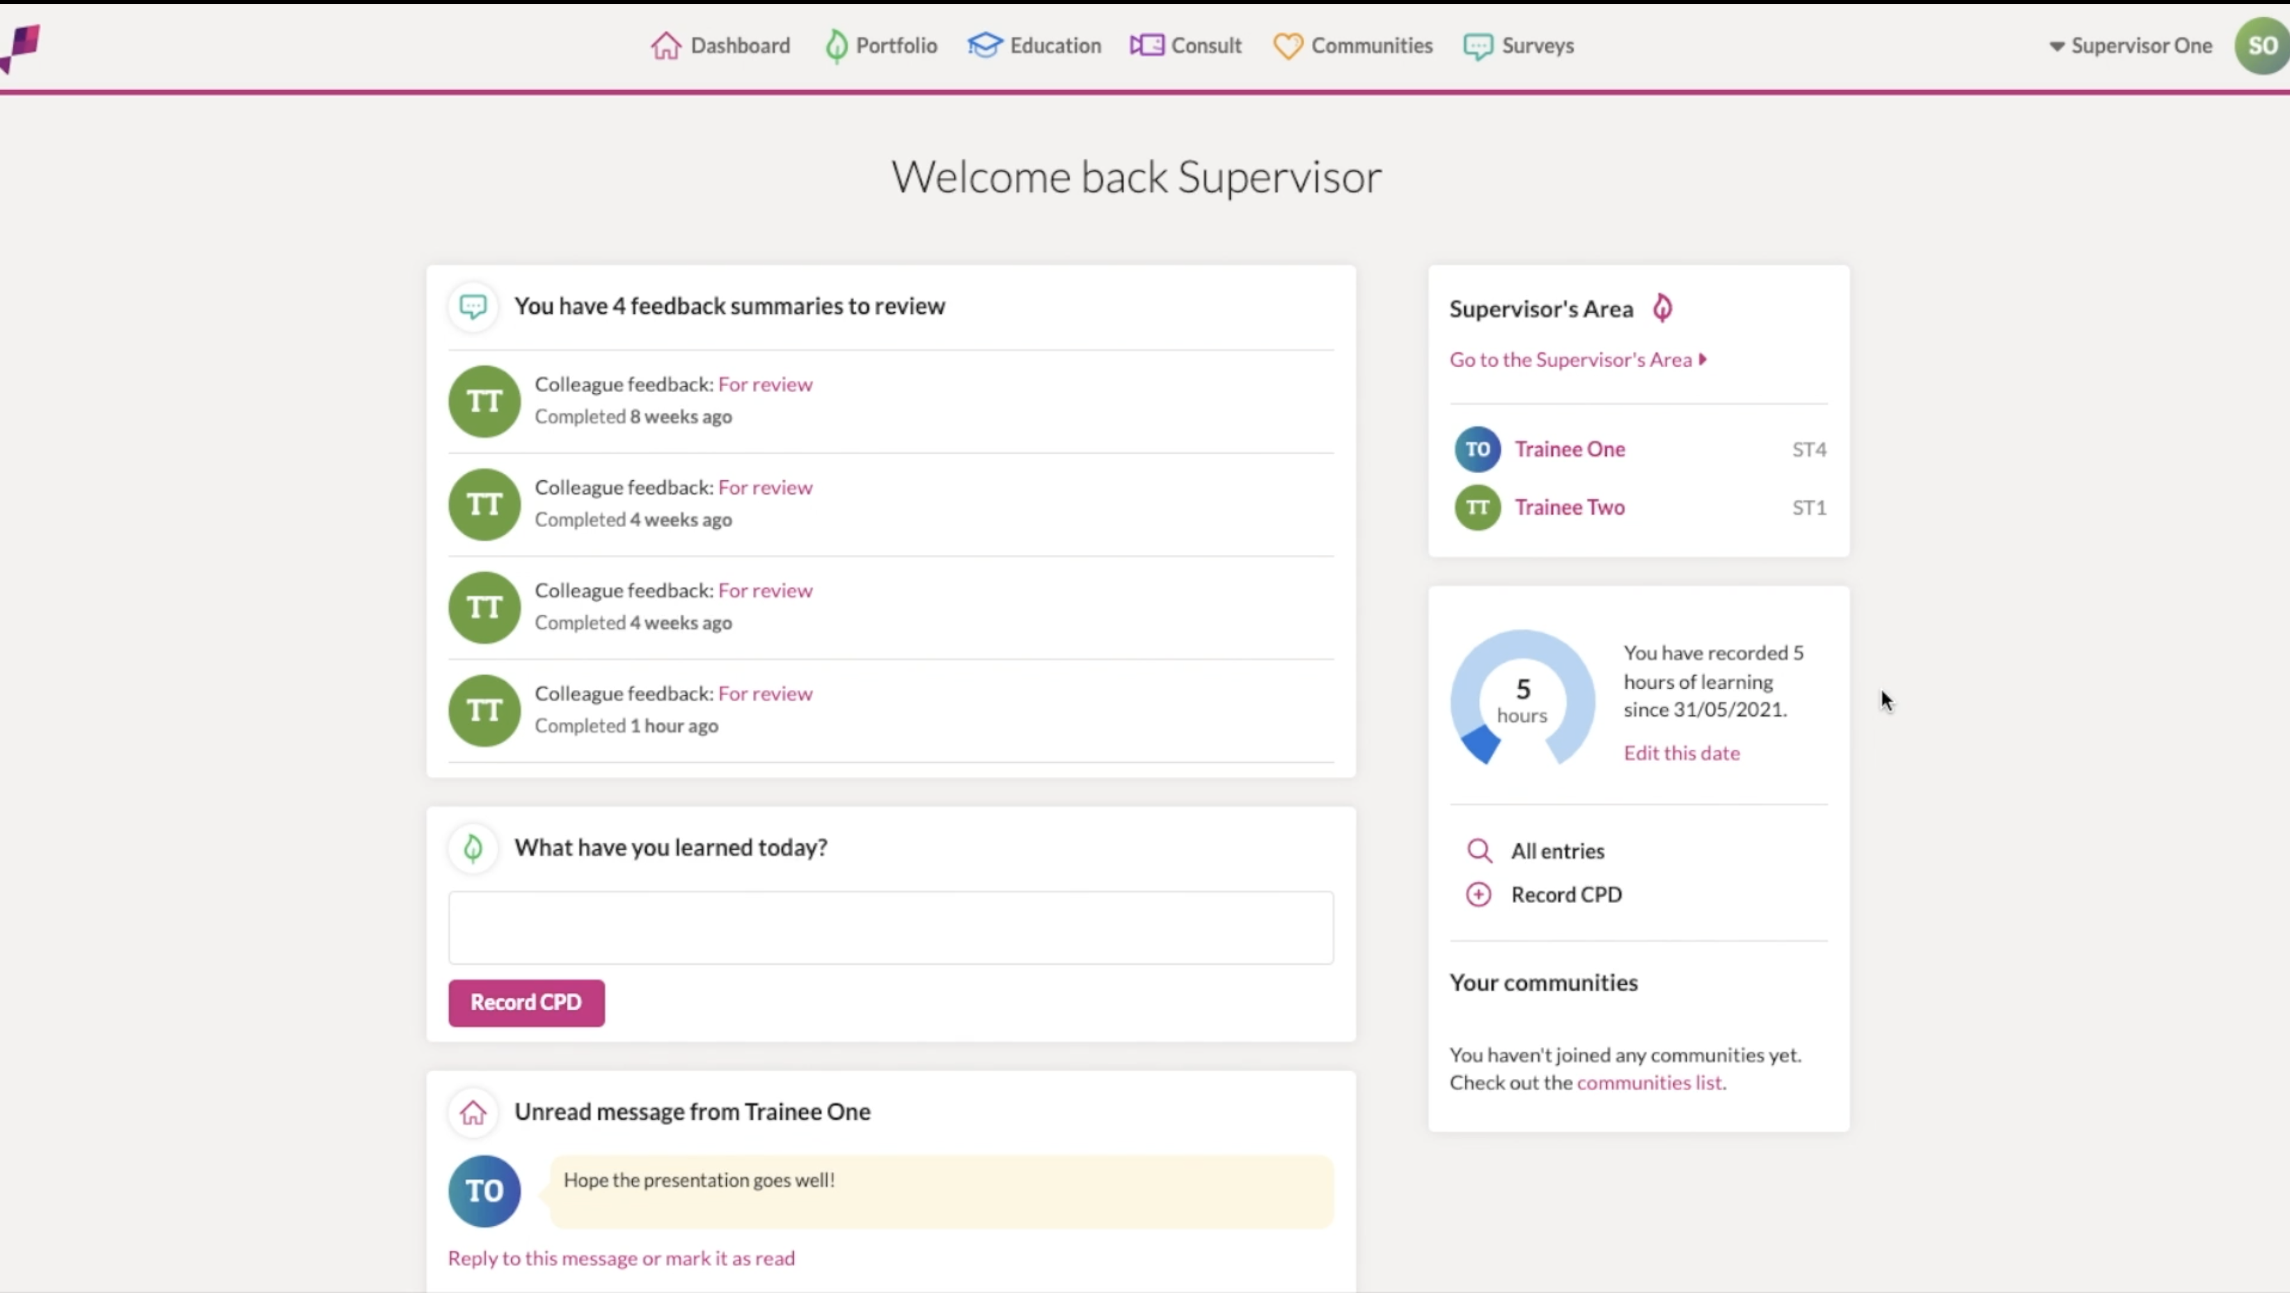
New ePortfolio
Trainees will not be able to use the old ePortfolio from 1 July 2024
All data will be migrated to the new e-portfolio
New ePortfolio will cater for current curriculum until August 2026

Slide 22
More Information
Curriculum 2024 website
https://www.rcophth.ac.uk/training/ophthalmic-specialist-training/ost-curriculum/curriculum-2024/
Curriculum 2024 email
curriculum2024@rcophth.ac.uk
Regional Curriculum Network
- Each region represented by TPD and trainee champion

